Slide 1
Topic Area:
Education & Awareness
TIME4CS Training Program 2

Slide 2
Topic Area: Education & Awareness
Training Program 2
Training Module 2.1: Training and awareness-raising in RPOs
Training Module 2.1.1: Strategies for training and raising awareness among researchers, volunteers, and other stakeholders
Training Module 2.1.2: Setting up training sessions for researchers and others
Training Module 2.1.3: Interactive session: Design your own training program
Training Module 2.2: Engaging schools and communities
Training Module 2.2.1: Involving schools in citizen science engagement
Training Module 2.2.2: Effective communication and engagement
Training Module 2.2.3: Interactive session: Crafting narratives and communication strategies in citizen science

Slide 3
Educational and awareness-building efforts in the field of citizen science
Training Program 2: Learning objectives
Gain a deep understanding of the importance of citizen science training and awareness in promoting responsible and inclusive research and innovation practices
Learn strategies for conducting impactful training sessions and awareness-raising activities tailored to researchers, volunteers, and other stakeholders within Research Performing Organizations (RPOs)
Develop the skills to conduct audience assessments and stakeholder analyses to tailor training experiences for specific groups and contexts
Explore the train-the-trainer concept and its application in disseminating citizen science knowledge within RPOs
Apply the fundamental components of the logic model to design training sessions that align with objectives, target audiences, and chosen training methods
Understand the challenges and opportunities of involving school children and communities in citizen science projects
Craft purposeful communication and engagement strategies tailored to larger and diverse audiences, advancing citizen science projects and building enduring connections with stakeholders beyond RPOs

Slide 4
Training and awareness-raising in RPOs
Training module 2.1

Slide 5
Strategies for training and raising awareness among researchers, volunteers, and other stakeholders
Training Module 2.1.1

Slide 6
Training and Awareness-raising
Inreach vs. outreach
Awareness-raising and training - capacity building – inside RPOs
Target groups are usually research staff, administration & support staff, students
Formats are often courses, seminars, lectures and workshops either online or in-person and usually conducted in a semi-formal way
Awareness-raising and training - capacity building – outside RPOs
Target groups are usually members of the public: individuals or groups of people who are often not scientists
Formats can take many forms like open days, stands at events and festivals, debates, talks, hands-on learning experiences and activity workshops. The format is usually informal and in-person

Slide 7
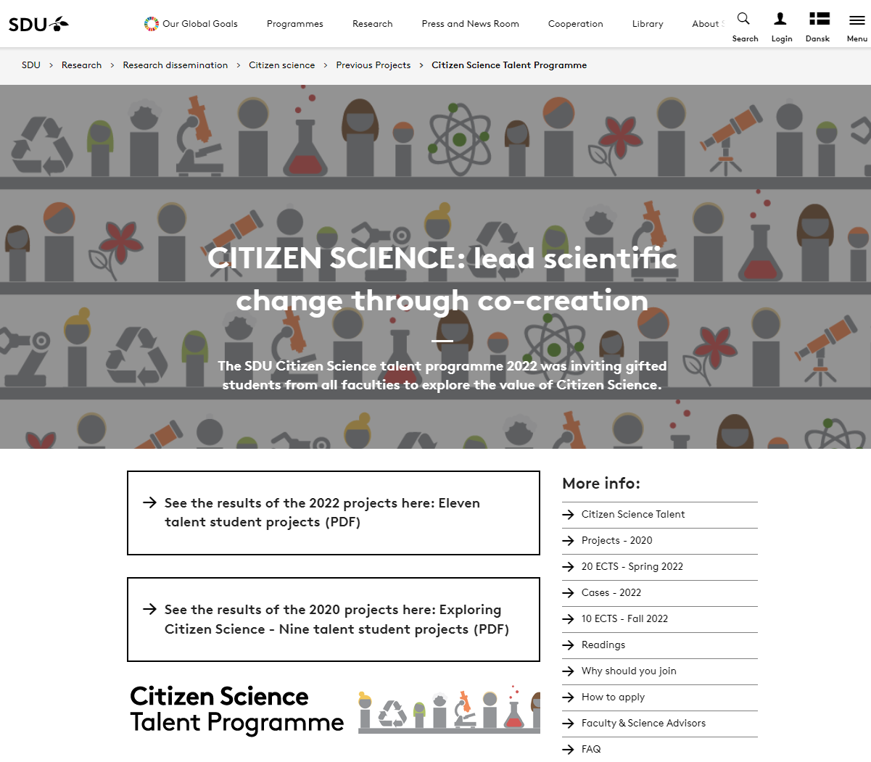
Academic courses: for Master students

Slide 8
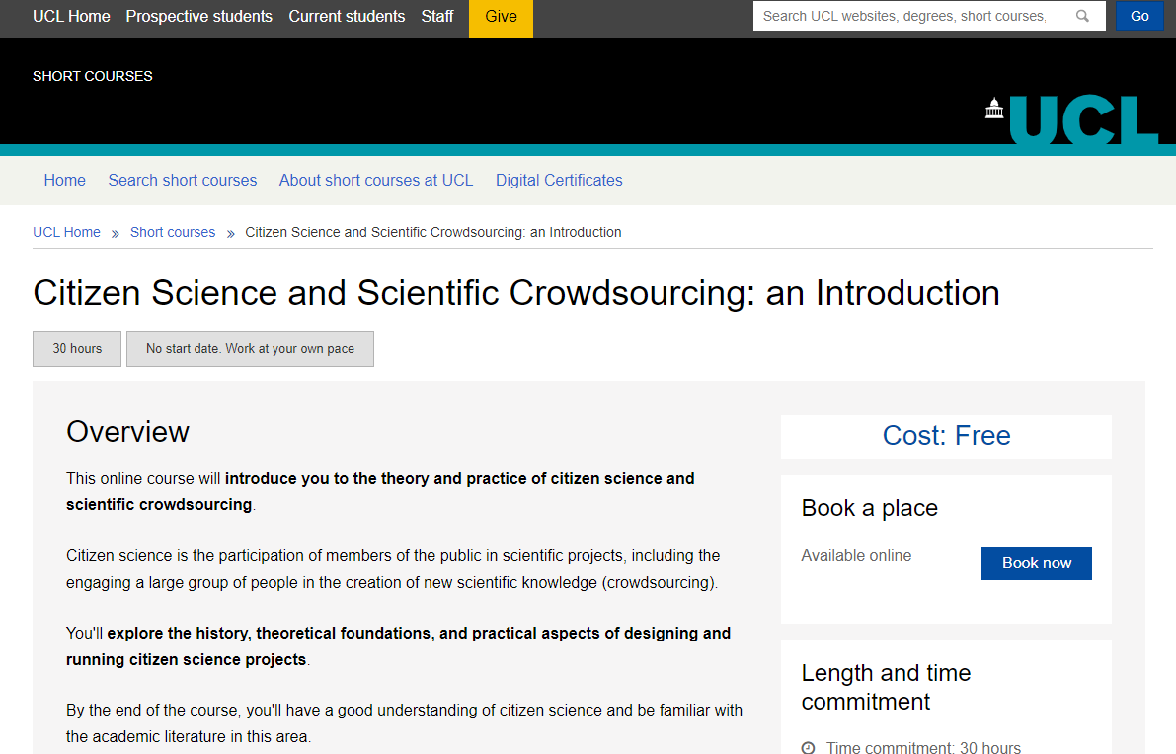
Academic courses: also open to the public
Onsite for UCL students (paid)
Online for ‘the public’ (free)

Slide 9
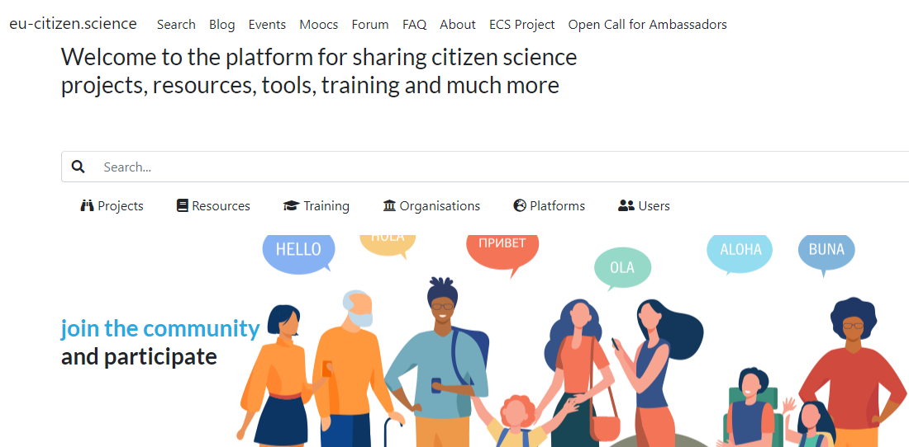
EU-citizen.science

Slide 10
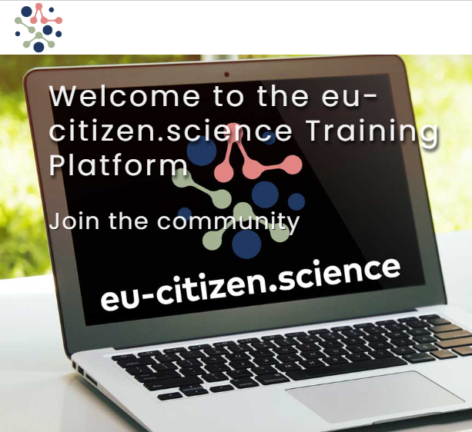
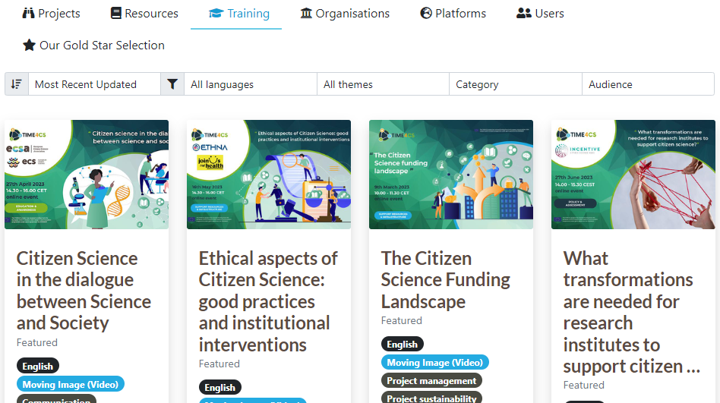
EU-citizen.science

Slide 11
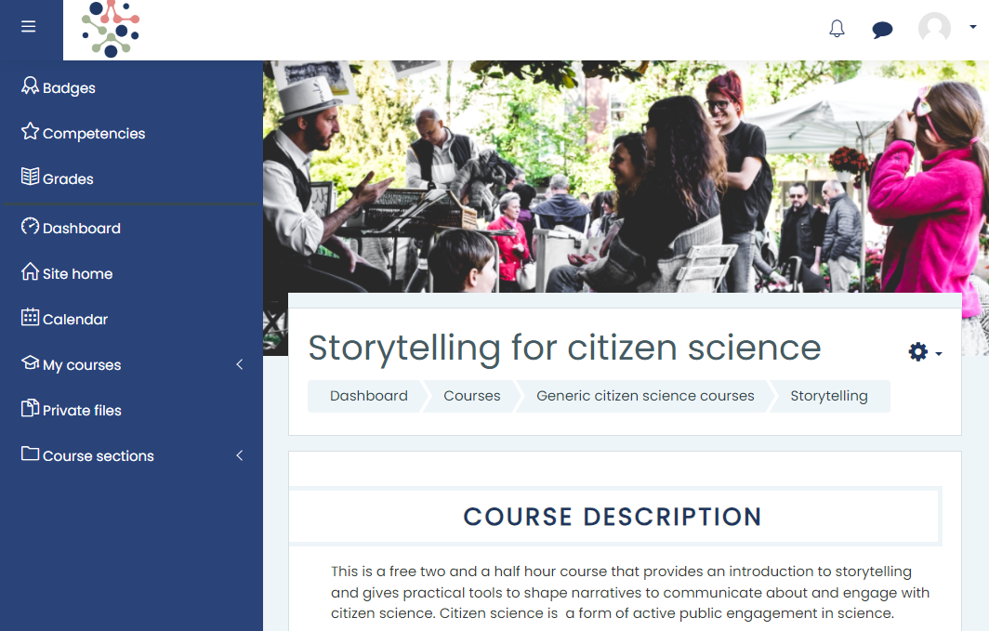
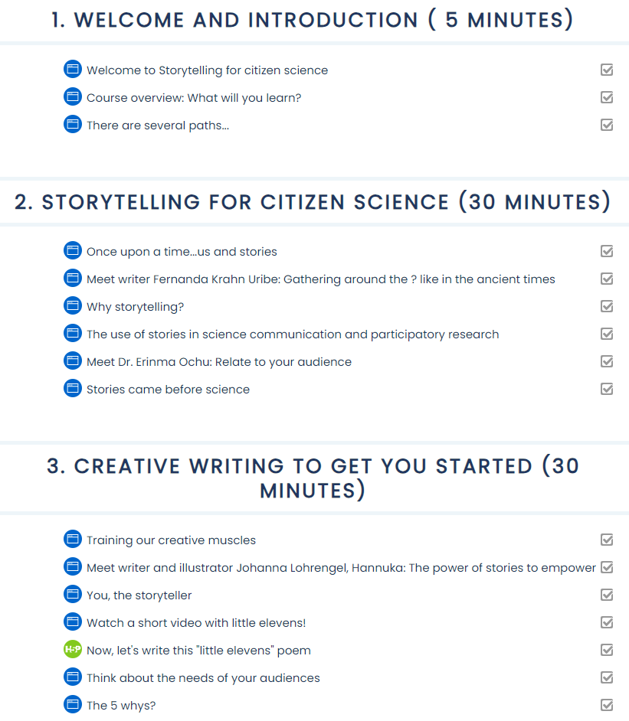
EU-citizen.science MOOC example

Slide 12
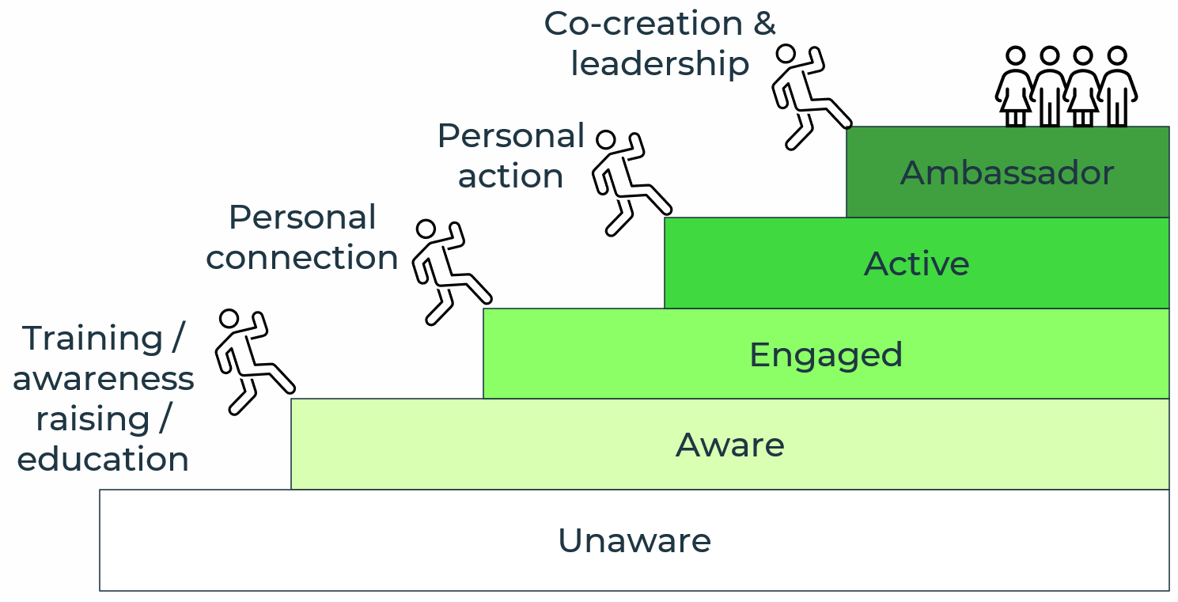
Training and Awareness-raising: Outreach
Why should people engage with you or your project?
CS volunteers’ top motivations:
Contributing to science & Interest in / concern about project topic (Values)
Learning something new (Understanding)← this is why your focus on volunteer training is important!
Training volunteers
Know your volunteers to know which formats will work for them
Lots of different formats! Good to offer more than one
Volunteers can train/guide other volunteers (also an important motivation for some: to use their current skills to help others and thereby also the project)

Slide 13
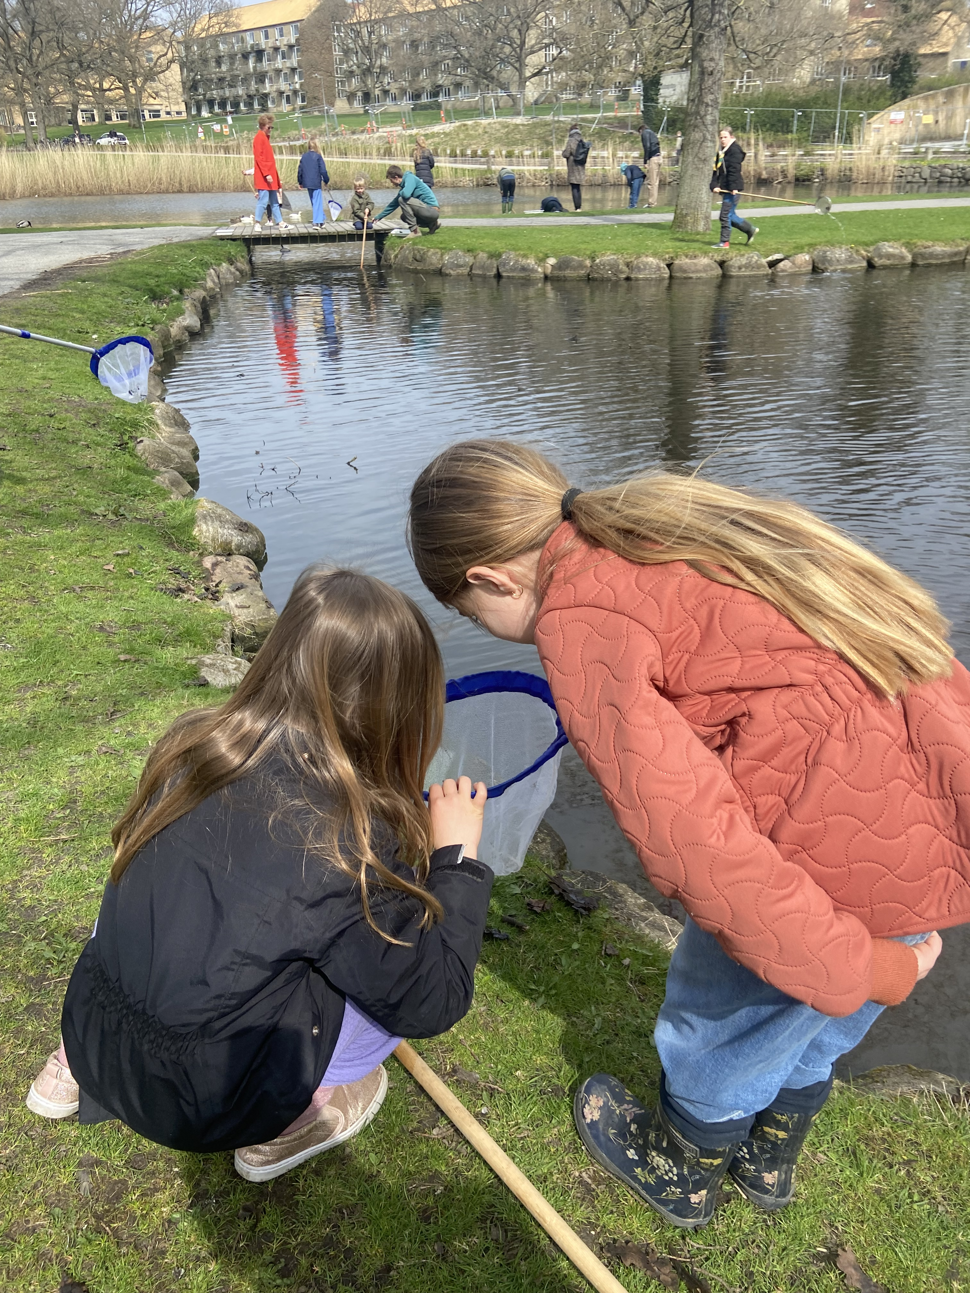
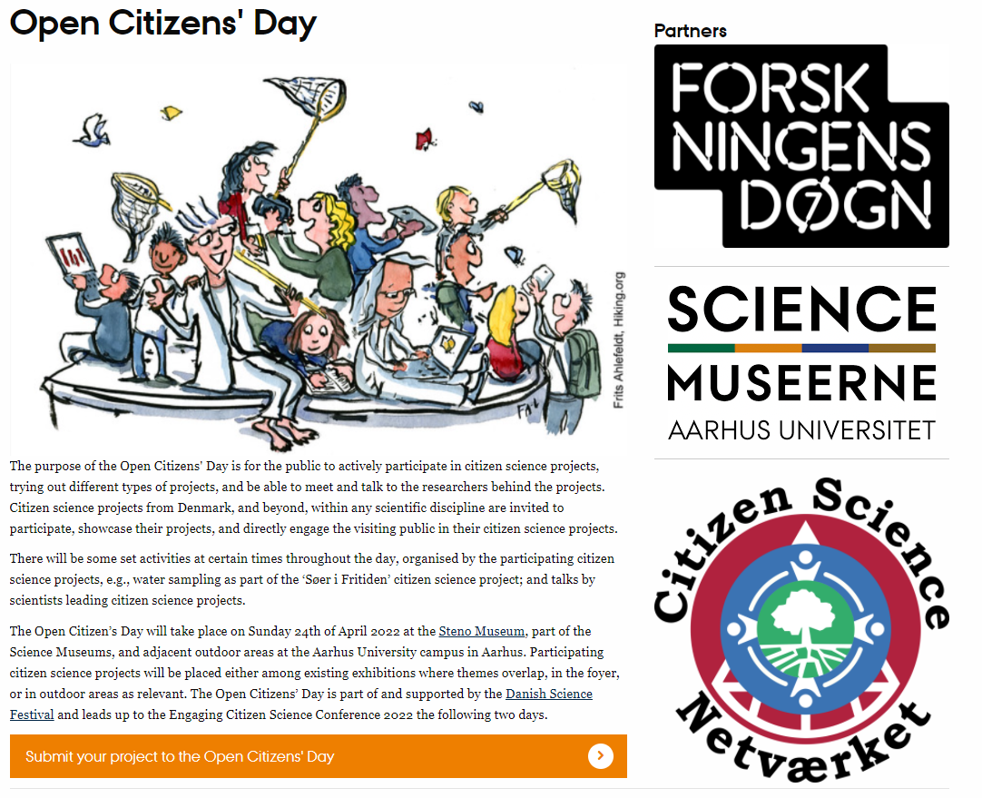
Awareness-raising

Slide 14
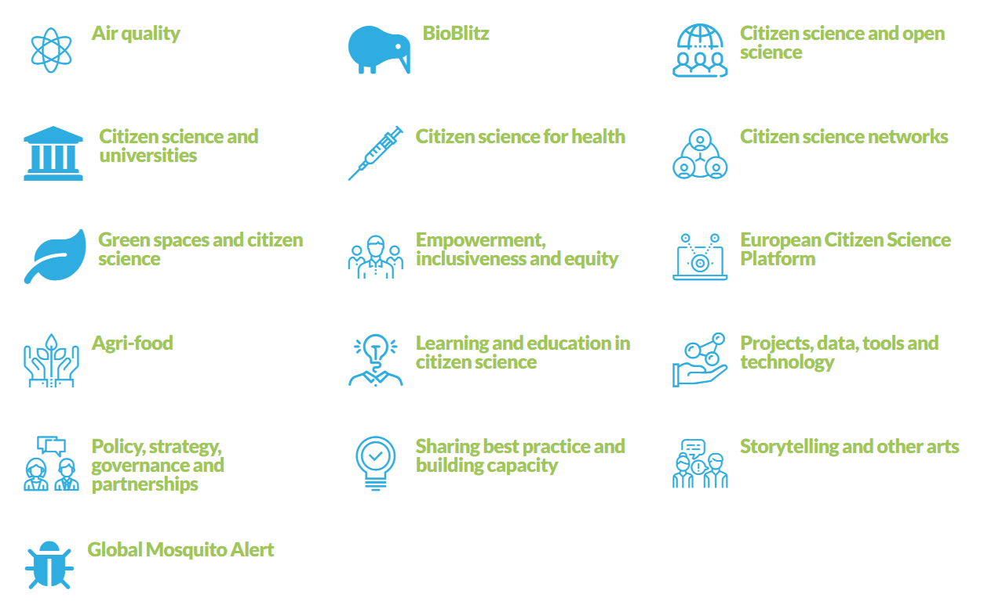
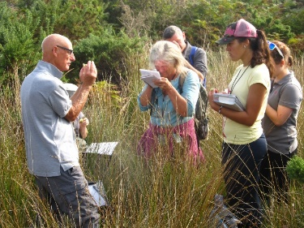
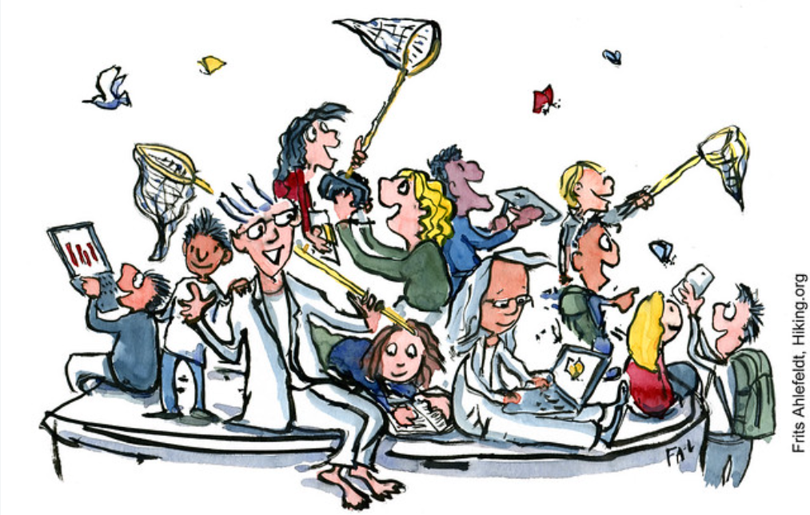
Training and Awareness-raising
Inreach (staff & students)
Outreach (‘the public’)
Curriculum-based, e.g. courses
Capacity-building, e.g. seminars and workshops
Informal mutual learning, e.g. peer-groups, mailing lists, Working Groups, e.g. European Citizen Science Association working groups
Awareness-raising (/recruiting)
Open days, festivals, science cafés
Competitions & challenges
Training of volunteers (/recruit & retain)
Hands-on activities
More practical than theoretical
Think about the social aspects
Make it fun!

Slide 15
Setting up training sessions for researchers and others
Training Module 2.1.2

Slide 16
Setting up training for staff in RPOs
Things to consider
Audiences and stakeholders
Who and when could or should someone be interested or impacted by your training, or have an influence on your planned training?
Content differs based on your training target audience
Researchers, other staff, or students
The Train-the-Trainer concept
Enabling more people to conduct trainings will enable more people to be trained

Slide 17
Core Team, Audience, Stakeholders for training
Stakeholders
Interest, influence,
impact, involvement
Audience
Training
Participants
(within (staff/ students) or outside (volunteers) RPO)
Core Team (you)

Slide 18
Core Team, Audience, Stakeholders for training
Stakeholders
Interest, influence,
impact, involvement
Audience
Training
Participants
(within (staff/ students) or outside (volunteers) RPO)
Core Team (you)

Slide 19
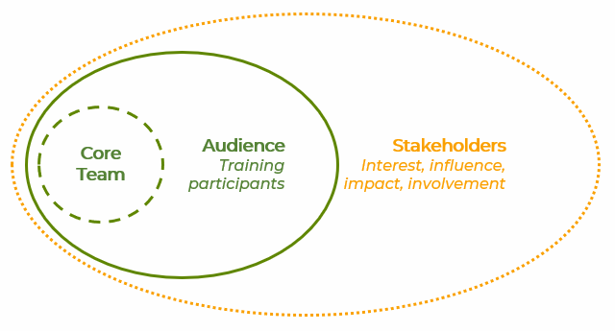
Stakeholder Analysis
Who are your stakeholders? Some initial questions
Who is/should be involved in making the training happen (approval, organising, execution, attendance, etc.)
What & how do they contribute?
What interests do the stakeholders have in the training?
What influence can or do the stakeholders have on the training?
How may stakeholders be affected or impacted by the training?
Which stakeholders are essential to involve?
At which stage do the stakeholders need to be involved?
Several ways to identify stakeholders
Several ways to think about their involvement - interest, influence, impact, roles, timing, etc.

Slide 20
Stakeholder Analysis example: Interest/Influence
Stakeholder mapping for CS Training implementation
Interest
High
Interest
Who is interested?
Who could you interest?
Who should be interested?
Influence
Who influences whether your training will happen or not?
Who is influenced by your training?
ECRs
Characteristics
……
……
Dean
Characteristics
……
……
External collaborators
Characteristics
……
……
Research Library Staff
Characteristics
……
……
Researchers
Characteristics
……
……
Influence
High
Low
Funding Officers
Characteristics
……
……
Heads of Department
Characteristics
……
……
Low
Place your stakeholders according to their level of interest and influence

Slide 21
Stakeholder Analysis example: Timing/Stakeholders
Stakeholder mapping for Citizen Science Training implementation within RPO
Stakeholders – any change agents?
Place your stakeholders according to when you need to involve them
Audience
External collaborators
Characteristics
External collaborators
Characteristics
Research Library Staff
Characteristics
Dean
Characteristics
Funding Officers
Characteristics
Heads of Department
Characteristics
Researchers
Characteristics
ECRs
Characteristics
Timing
Planning – Design – Coordination – Outreach – Execution – Evaluation – Follow-up

Slide 22
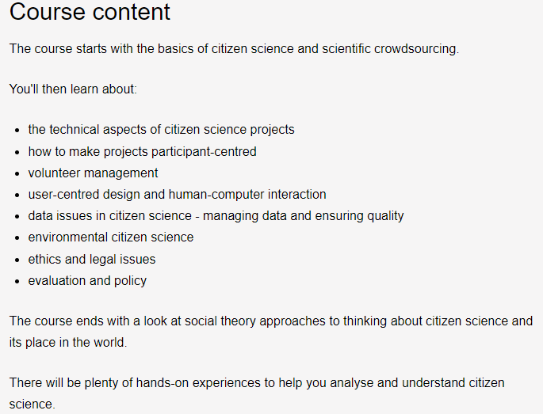
What researchers need to know about CS
Some theory and some practice
Theory (and some cases)
Inspiration from online courses, e.g. UCL course:
Technical aspects
Volunteer management & communication
Data issues & data management
Topic-specific approaches (inspiration from cases)
Ethics & legal aspects (e.g. GDPR)
Evaluation
(Policy)

Slide 23
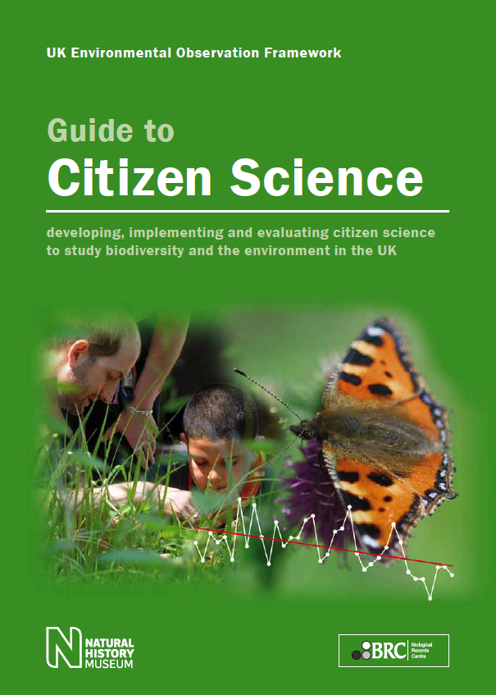
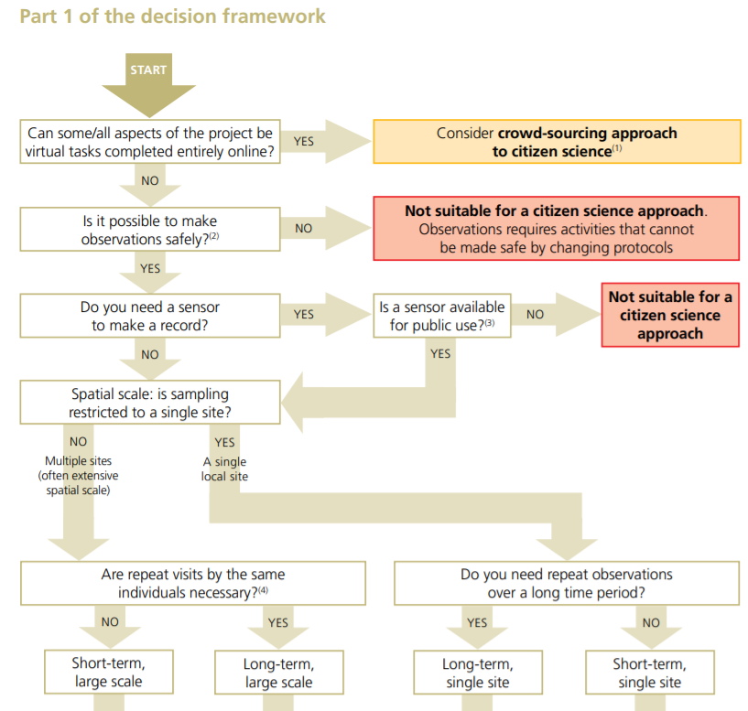
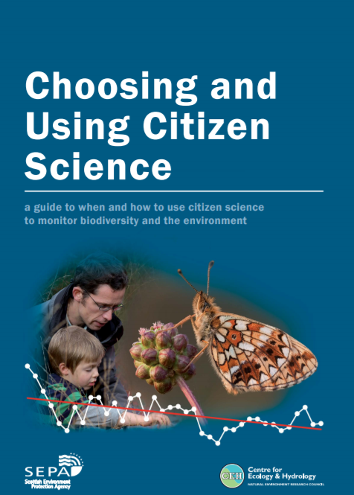
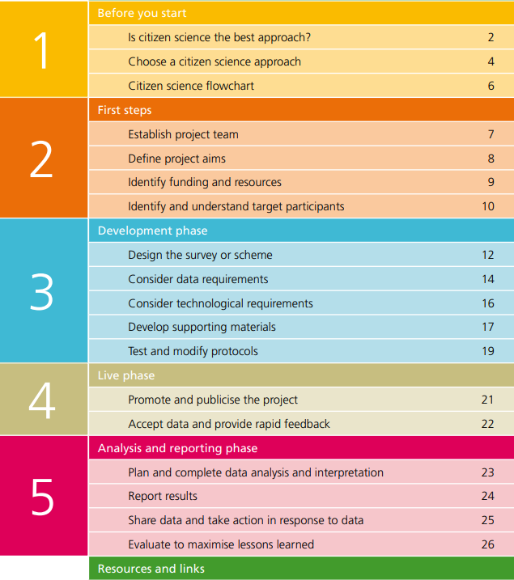
What researchers need to know about CS
Some theory and some practice
Practice
CS is a method like any other scientific method
– only use when appropriate!
Pocock et al. 2014: https://www.ceh.ac.uk/citizen-science-best-practice-guide

Slide 24
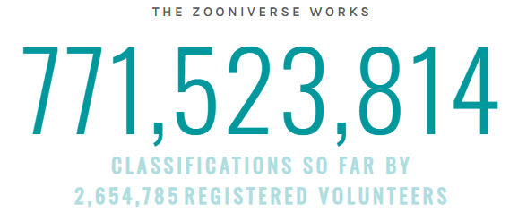
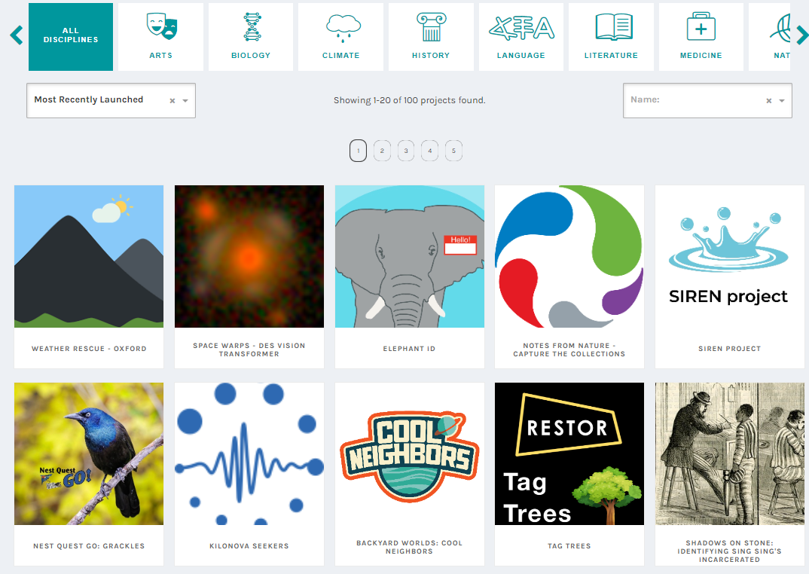
What researchers need to know about CS
Some theory and some practice
Practice!
A great way to learn and get inspiration is to participate in citizen science projects!
An easy way is to try out projects on Zooniverse.org (usually around 100 projects)
Try to find local projects you can participate in as well (not necessarily only within your own discipline!)

Slide 25
What other RPO staff need to know about CS
Depends who your audience is! (communication staff, funding staff, administrators)
For all:
Theory (but not too much)
What citizen science is (and is not)
Enable their participation in an ongoing citizen science project (practice)
What the proposed citizen science project is about
Specific to their role:
Why their role is important for a successful citizen science project
How they can support researchers with citizen science projects, identifying specific tasks:
identifying and applying for funding
running communications and outreach
volunteer management
IT platform development & maintenance
support on legal and ethical aspects

Slide 26
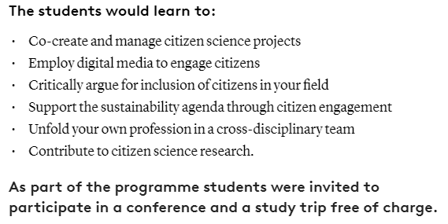
What students need to know about CS
Some theory and some practice
Theory (and some cases)
Inspiration from courses, e.g. UCL course (past slide) or SDU course:
Reasons to include citizens
Co-creation
Managing citizen science projects
Learning to work cross-disciplinarily
How to contribute to (citizen science) research
Practice
Include field trips, citizen science project visits and/or conference attendance

Slide 27
What students need to know about CS
Some theory and some practice
Practice!
A great way to enhance understanding and learn is to participate in citizen science projects!
An easy way is to try out projects on Zooniverse.org (usually around 100 projects)
Try to find local projects your students can participate in as well (not necessarily only within their own discipline!)

Slide 28
Trainer (you)
New trainer
Trainees (staff/students/ volunteers)
Trainees (staff/students/ volunteers)
New trainer
Trainees (staff/students/ volunteers)
Trainees (staff/students/ volunteers)
Train-the-Trainer (TTT) concept
Train-the-Trainer
Training more trainers
Choose the important points to cover for your audience and project (e.g. from list on the right)
In our 2-hour citizen science TTT, we focused on:
Audiences and stakeholders
Training design
Identifying challenges and solutions to implementing the suggested training
MOOC course on EU-citizen.science

Slide 29
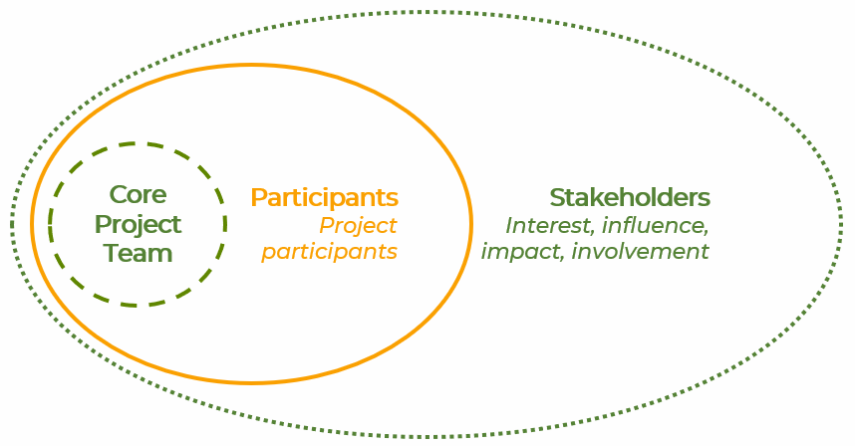
Stakeholder Analysis: Timing of Participant training
Stakeholder mapping for Citizen Science participant / volunteer training
Participants
Participants
Participants
Participants
Stakeholders – any change agents?
Place your stakeholders according to when you need to involve them
External collaborators – break this down further, who are they?
Director / Board
Research Library Staff
Heads of Department
Early Career Researchers
Researchers
Funding Officers
Timing
Planning – Design – Coordination – Outreach – Execution – Evaluation – Follow-up
Participants
You might need different types of volunteer training at different times of your project

Slide 30
Stages of participation
Awareness-raising & training focus
Volunteer perspective
Project perspective
Seeing posters / flyers
Events / talks
(Social) media
Word-of-mouth
Getting to know project & people
Intro meeting w. information
Getting to know the tasks
Receive training
Building confidence
Exploring involvement & opportunities
Empowerment
Ongoing involvement
Provide feedback to project
Create posters / flyers
Events / talks
(Social) media
Encourage people to talk about the project
Welcome!
Intro meetings
Volunteer handbook
Run trainings
Support at tasks
Provide learning and development opportunities
Offer new training & development opportunities
Retain volunteers
Create Ambassadors
Respond to feedback
Timing
Awareness – Recruitment – Onboarding – ‘Tasks’ (training) – Learning & Development – Follow-up (ongoing)

Slide 31
Plan your training programme
Make it a positive experience for your volunteers, not a chore they feel they have to do
Set training goals (your goals and goals for volunteers)
Make volunteers feel welcome
Focus on hands-on, practical training (even if online!)
Make your training accessible
Ask for feedback – and act on it

Slide 32
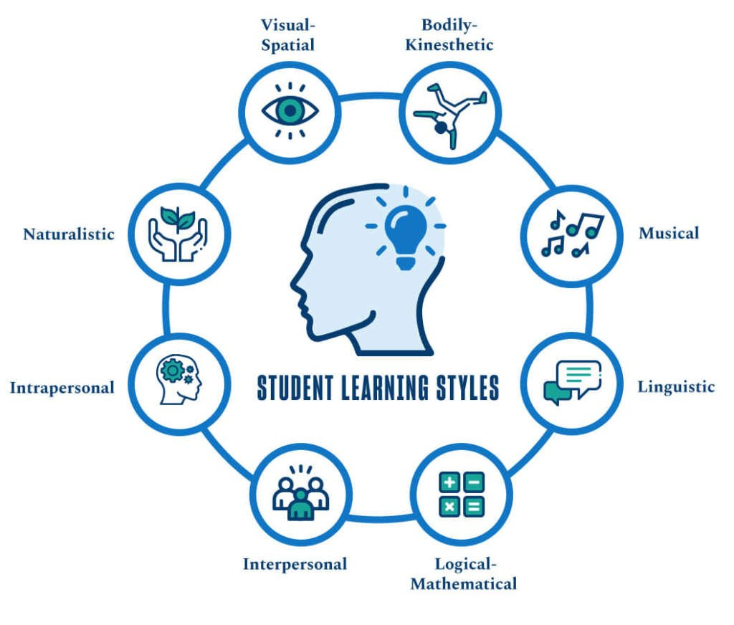
Learning & Teaching/Training Styles
Learning styles Teaching styles
Lots!
Facilitator
The facilitator’s job is to support everyone to do their best thinking.
To do this, the facilitator encourages full participation, promotes mutual understanding and cultivates shared responsibility.
By supporting everyone to do their best thinking, a facilitator enables group members to search for inclusive solutions and build sustainable agreements.
University of San Diego
Kaner & Berger, 1996

Slide 33
Getting to know project & people
Intro meeting w. information
Onboarding (recruitment)
Make volunteers feel welcome!
Welcome!
Intro meetings
Volunteer handbook
Introductory Information Session / Meeting
Information about the organization and the project: aims, methods of involvement, project expectations and data needs
Volunteer handbook
Ideally there is a volunteer handbook where all the important information can be found
Expand it as the project develops – ask for volunteers to contribute (they know about their own role and what it is important to know. Acknowledge them!)
Get to know your volunteers!
Engage volunteers in discussions and get to know them. What are their motivations and expectations – what needs to happen for them to stay involved?

Slide 34
Getting to know the tasks
Receive training
Building confidence
Task Training (building confidence)
Run trainings
Support at tasks
Provide learning and development opportunities
Active participation
Task training
Provide task training. Think about staging it, if possible. Volunteers may not need all the information / training from the start. Recognise that some volunteers may come in with a lot of experience and may not need the ‘basic’ training – maybe they can even help train?
Provide a variety or types of training, make it interesting: use storytelling, games, competitions, volunteer collaboration groups, etc.
Provide support
Ensure support is provided to volunteers. Questions will come up. An option is to provide a forum where also other volunteers can respond and provide answers, also further involving them in the project
Provide learning and development opportunities
Provide more advanced training opportunities, if training is staged. Offer opportunities for other types of involvement, e.g. attending conferences and meetings and having volunteers give their perspective from the project

Slide 35
Exploring involvement & opportunities
Empowerment
Ongoing involvement
Learning & Development Opportunities
Offer new training & development opportunities
Retain volunteers
Create Ambassadors
Empowerment and retention
Offer expanded learning and development activities
Identify new opportunities and explore with volunteers what new learning and development activities they would like within the project. Accept that some will not want any and are happy with their current engagement in your project
Empowering volunteers
Enable and train volunteers to take on Ambassador roles. Training here includes how to engage with and possibly manage other volunteers, or take on more responsibility and other tasks than ‘standard’ volunteers. Continue providing support to your Ambassadors! They are important in further recruitment of new volunteers as well. Do not focus on your Ambassadors at the expense of your ‘standard’ volunteers – keep both feeling welcomed, important and empowered

Slide 36
Planning for Volunteers: The Logic Model
Resources: What do we need? | Activities: What do we do? | Outputs: What happens immediately? | Outcomes: What are my goals: short- and long-term? | Impacts: What may happen ultimately?
Types of resources needed | Types of activities and actors | Direct products of activities and trainings | Behavioral and social change (new motivations, practices and communities) | Changes in assumptions, values, policies, attitudes, aims, contextual factors
Specific resources available | Specific activities planned | What the participants specifically produce or learn | Benefits to participants | Organizational change
Staff/volunteer capacity, money, facilities, materials, partnerships | Events, trainings, tasks, group work, tool use, actions, processes | Cognitive, attitudinal, and social capacities or connections | Better data collection, better engagement & empowerment of volunteers | Addition to / change in scientific knowledge

Slide 37
Design your own training program
Training module 2.1.3: Interactive session

Slide 38
Interactive session: Design your own training inside or outside RPO
Program | Task
Introduction | Briefly introduce the logic model as a tool for planning and evaluating CS training programs. Explain the session's objective: to create a structured plan for a CS training session.
Group formation | Divide participants into small groups or set them up to work individually. Provide each group or individual with a template of the logic model and necessary materials (pens, paper, or digital tools).
Designing the training | Participants use the logic model to develop their CS training plan. This involves identifying inputs (resources needed), activities (what will be done), outputs (immediate results), outcomes (short and long-term goals), and impacts (broader changes or benefits). Encourage creativity and practicality, considering factors like audience, content, resources, and desired outcomes.
Sharing and feedback | Each group or individual presents their logic model-based training plan. Encourage peer-to-peer feedback, focusing on the feasibility, clarity, and potential impact of each plan.
Evaluation and conclusion | Conclude the session by highlighting the importance of structured planning in effective training program design. If time allows, the facilitator can provide brief, overarching feedback, emphasizing key takeaways.

Slide 39
Engaging schools and communities
Training Module 2.2

Slide 40
Involving schools in citizen science engagement
Training Module 2.2.1

Slide 41
Why is it important to learn about collaboration with schools in citizen science?
Key take-aways
Engaging in citizen science within school settings can yield scientific results, and schools, educators, and students can experience valuable advantages by participating
Educational enrichment: enhance students' learning experiences by providing real-world applications of scientific concepts
Community engagement: strengthen ties between schools, communities, and the broader scientific community
Sustainable impact: forster scientific literacy and environmental stewardship, and the next generation of scientists

Slide 42
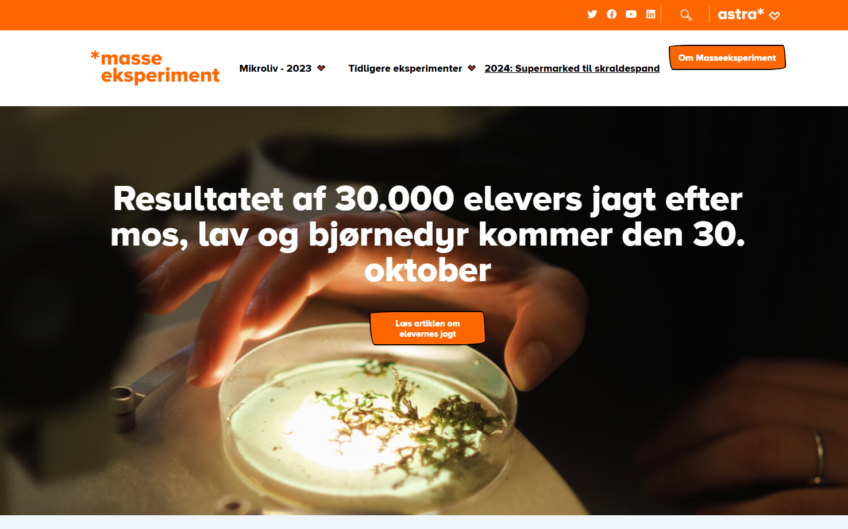
Masseeksperimentet (The Mass Experiment)

Slide 43
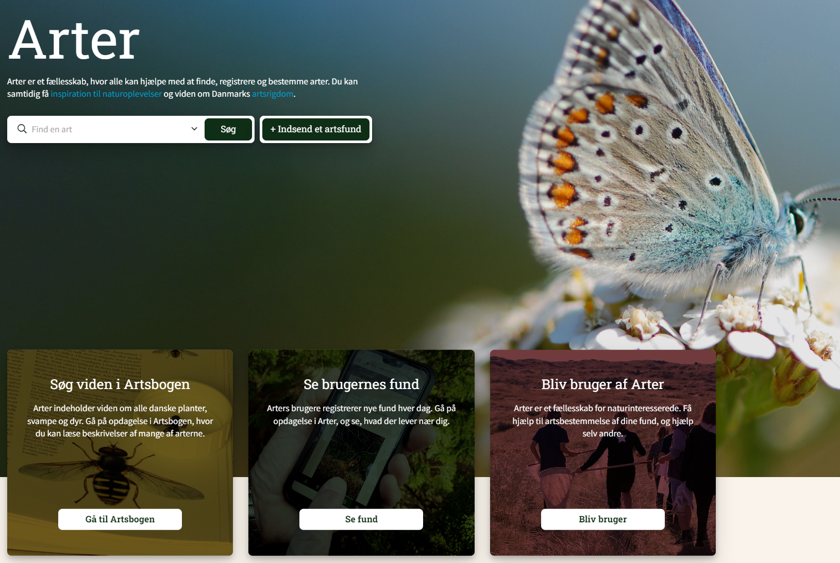
Masseeksperimentet (The Mass Experiment)

Slide 44
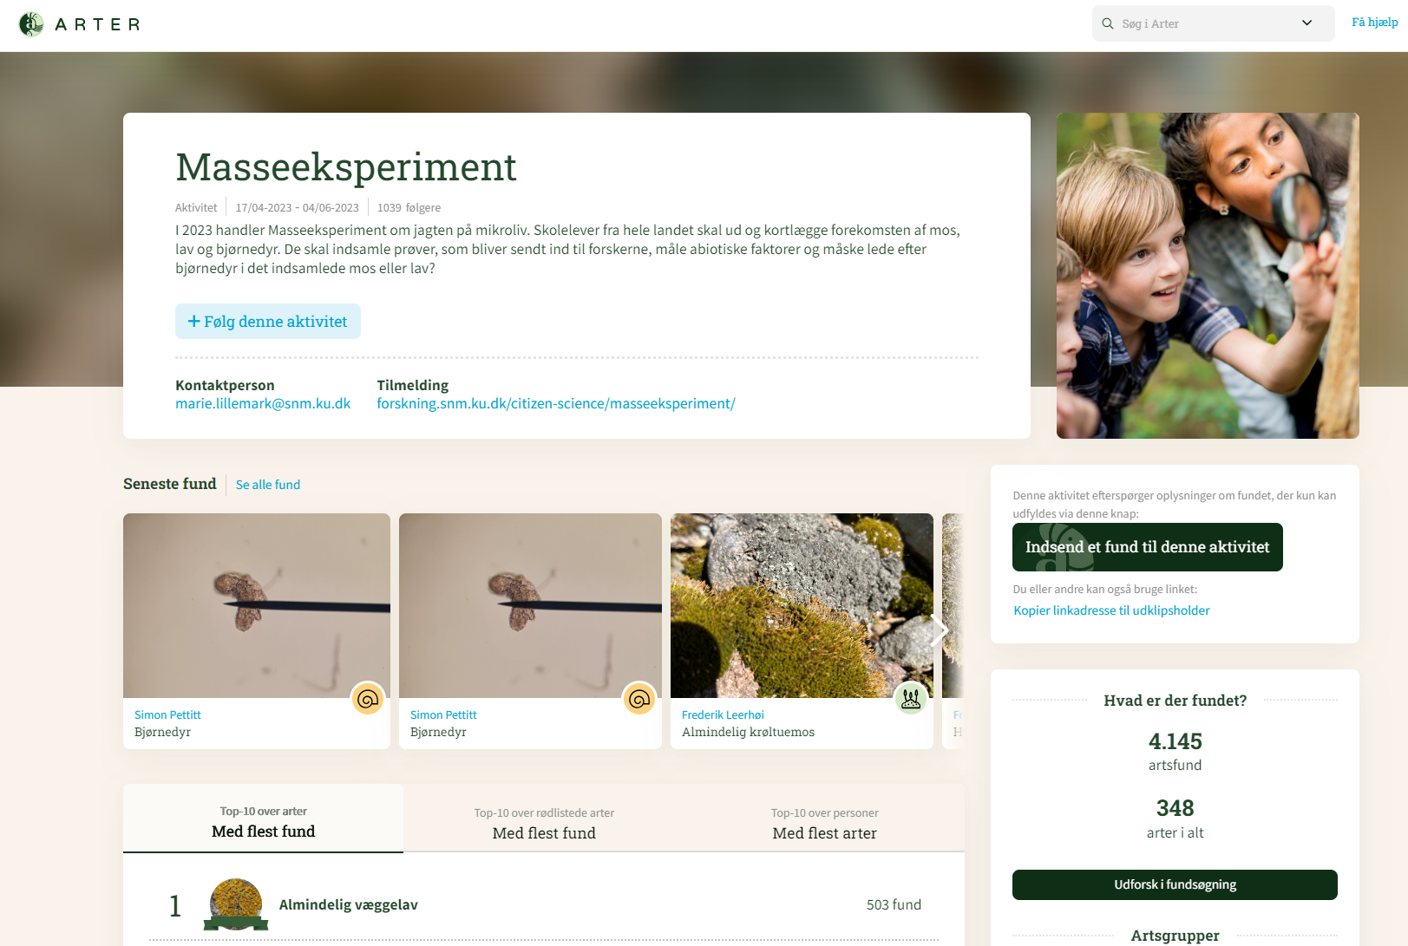
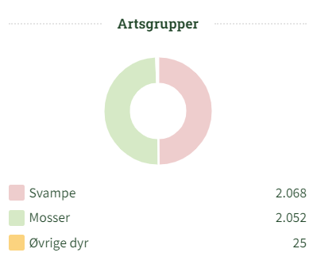
Masseeksperimentet (

Slide 45
The Mass Experiment in Danish Schools
Scientific impact: New knowledge and insights
The advancement of (useful) scientific knowledge
The project is the largest survey of mosses, lichens, and tardigrades in Denmark
5 new tardigrade species may have been discovered
Furthermore, as microfauna are sensitive to air emissions resulting from agriculture, industry, and transportation, the data will aid the researchers in understanding the effects of human-environment interactions on biodiversity

Slide 46
The Mass Experiment in Danish Schools
Educational impact: Motivation and empowerment
The advancement of learning and engagement
The pupils' motivation will increase when they engage in authentic, scientific investigations, and when the data they provide is actually used to produce scientific results
The Mass Experiment will enhance the pupils' scientific literacy and their science capital (their knowledge, attitudes, participation, experiences), empowering them to engage with science and scientific issues in the future

Slide 47
Collaborating with schools for effective citizen science engagement
The value of citizen science for schools
Enhanced learning and understanding of science
Citizen science engages students in real-world scientific research with hands-on learning, critical thinking, and problem-solving
Community engagement and civic responsibility
Schools' participation in citizen science projects connects students with their local communities and the broader scientific community

Slide 48
Collaborating with schools for effective citizen science engagement
The value of citizen science for schools
Scientific literacy, informed decisions, and STEM careers
Citizen science empowers students to become scientifically literate citizens by developing skills to analyze data, make informed decisions, and contribute to scientific knowledge
Environmental awareness and sustainable practices
Through citizen science, students may gain a heightened awareness of environmental issues, conservation efforts, and eco-friendly behavior

Slide 49
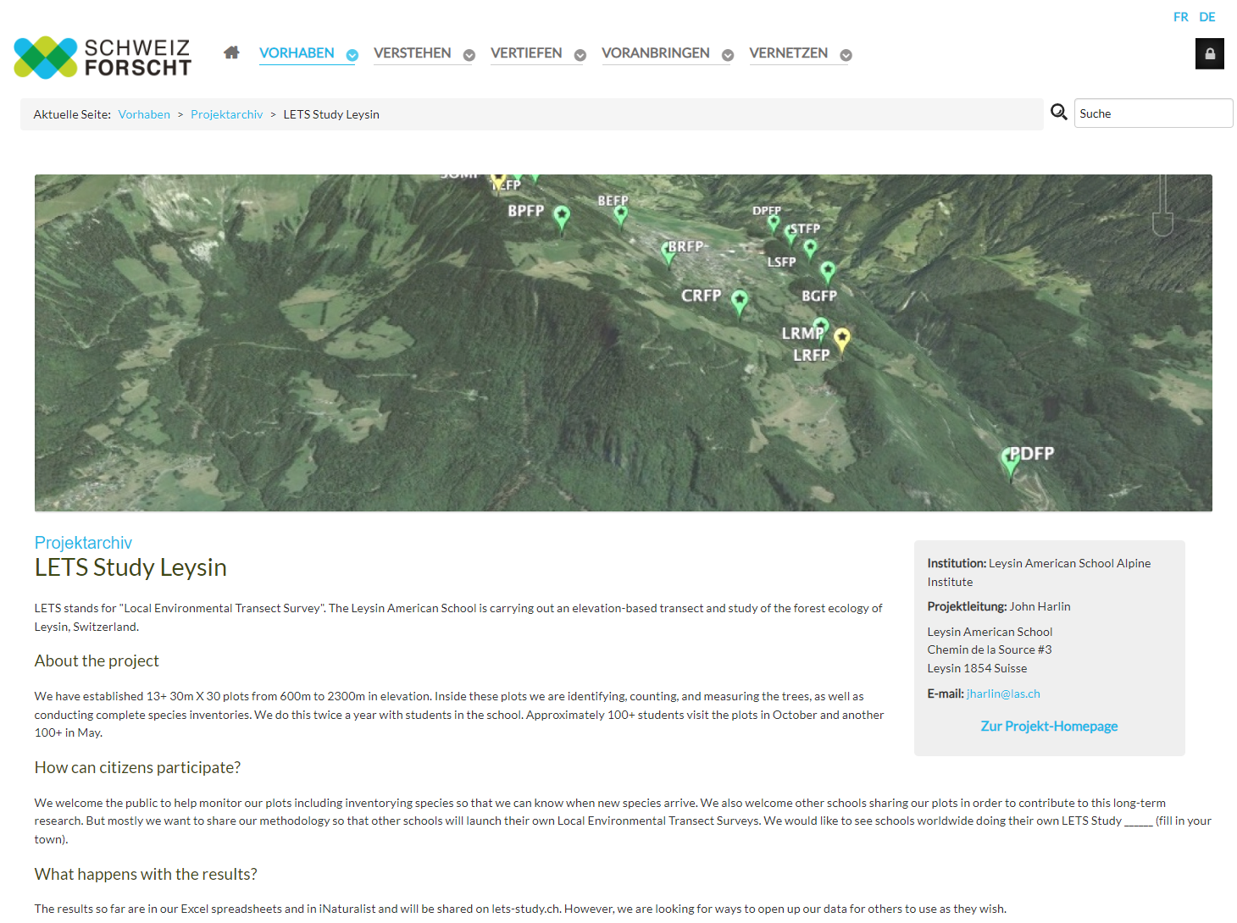
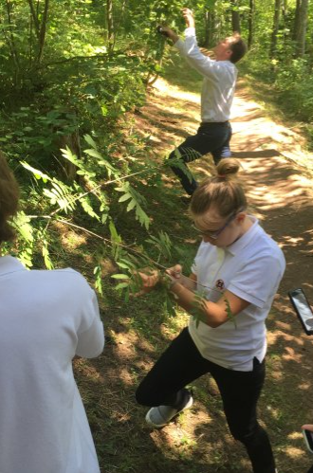
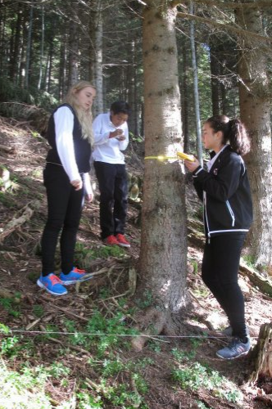
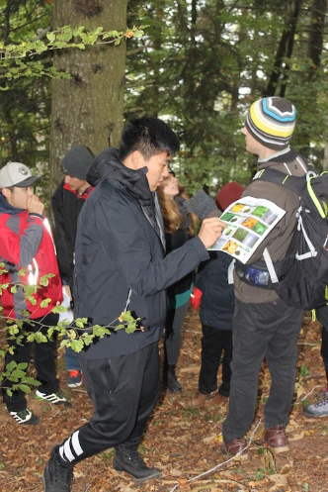
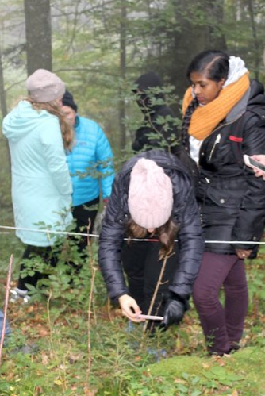
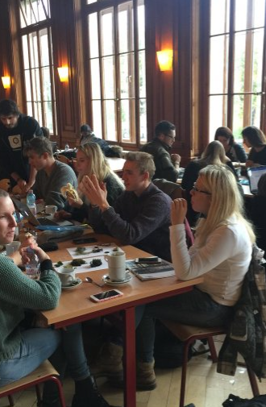

Slide 50
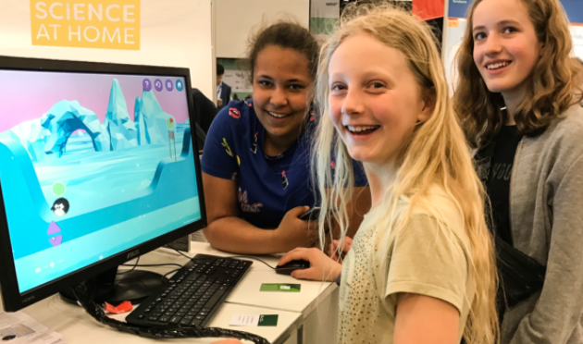
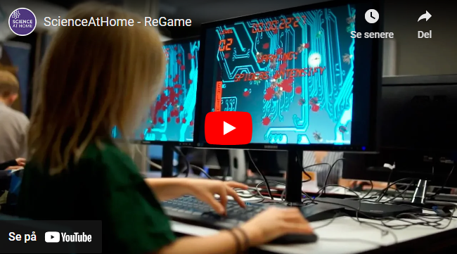

Slide 51
Collaborating with schools for effective citizen science engagement
Guiding design principles for citizen science in schools
Curriculum alignment
Integrating citizen science projects into the school curriculum, reinforcing key science concepts and skills
Problem-based learning (PBL) design
Engaging students in active learning by presenting them with real-world scientific challenges
Collaboration with teachers
Leveraging the expertise of educators to design and implement effective citizen science programs

Slide 52
Teachers are important gatekeepers, but also serve as team leaders and data quality filters

Slide 53
Developing material for education and learning opportunities in citizen science
Three relevant socio-cognitive contexts to consider
The science context
Aligning learning materials with the relevant scientific principles, methods, and terminology to give participants a solid foundation
The context of participation
Tailoring educational materials to accommodate various skill levels and learning styles, and to promote an inclusive environment
The project-specific context
Adapting materials to the unique goals, objectives, and data collection methods of the citizen science project

Slide 54
Recognizing the diversity of learning outcomes
Participants can acquire a range of skills and knowledge
Scientific understanding and skills
Participants may gain domain-specific knowledge, deeper understanding of scientific processes, and develop critical thinking
Cultivating communication, collaboration, and awareness
Participants may develop communication and collaborative skills, and they may gain awareness of environmental and social issues
Empowerment, a sense of responsibility, and advocacy
Participants gain insight into project management and teamwork, and may become advocates for science and community involvement

Slide 55
Effective communication and engagement
Training Module 2.2.2

Slide 56
What makes communication and engagement with participants in citizen science crucial?
Key take-aways
Effective communication and engagement ensures common understanding of goals, methods, and process, while also building a sense of community
Data quality and reliability: engaging with participants promotes data accuracy, reliability, and validity
Motivation and retention: help partipants feel committed over time, encouraging continued involvement and sustained contribution
Public awareness and impact: foster participants' ownership, so that they are more likely to share knowledge and experiences

Slide 57
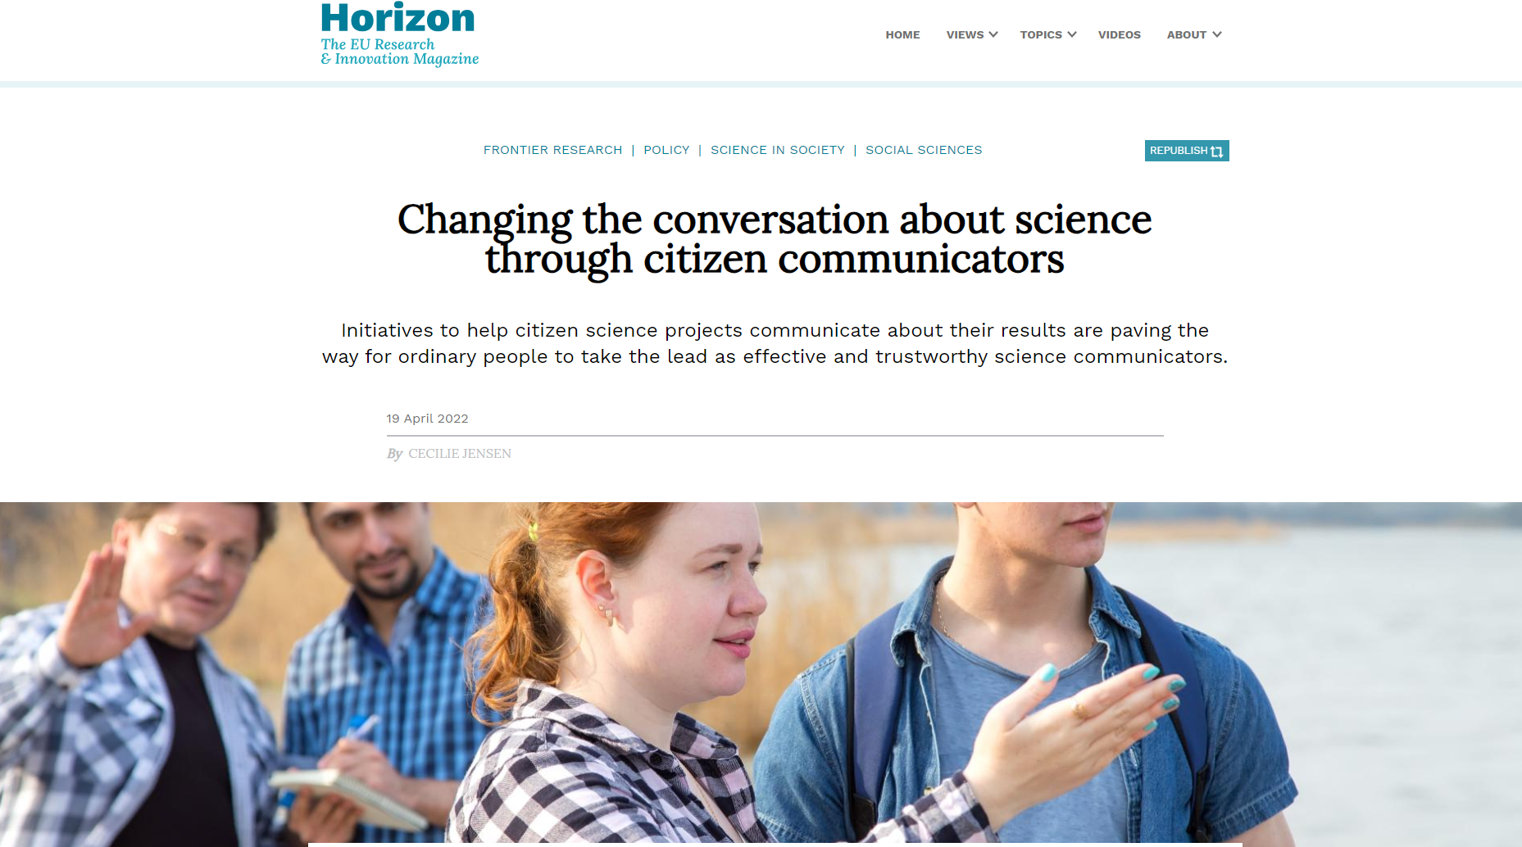

Slide 58
Every good citizen science project comes with a solid and sustainable communication plan
The building blocks of the communication plan
Determine the project aims and indicators
Often a balance between contributing to science, raising public awareness of a scientific issue, involving members of the public in setting the research agenda and finding solutions to social issues
Define the level of engagement
Participants may help in any one of these tasks: 1) setting the research question; 2) searching for information; 3) formulating a hypothesis; 4) choosing the data collection methods; 5) gathering, analysing and interpreting data; 6) writing and disseminating conclusions; and/or 7) discussing the results

Slide 59
Every good citizen science project comes with a solid and sustainable communication plan
The building blocks of the communication plan
Specify the target audience(s)
Consider target group demographics or segments (primary, secondary, and intermediate), and define channels, messages, and the degree of interaction and inclusivity accordingly
Understand what motivates the audience(s)
Participants may be driven by a mix of extrinsic motivations, such as recognition, status, identification, and other benefits, and intrinsic motivations, such as enjoyment, personal growth, sense of purpose, learning and skill development etc.

Slide 61
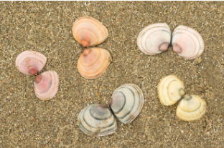
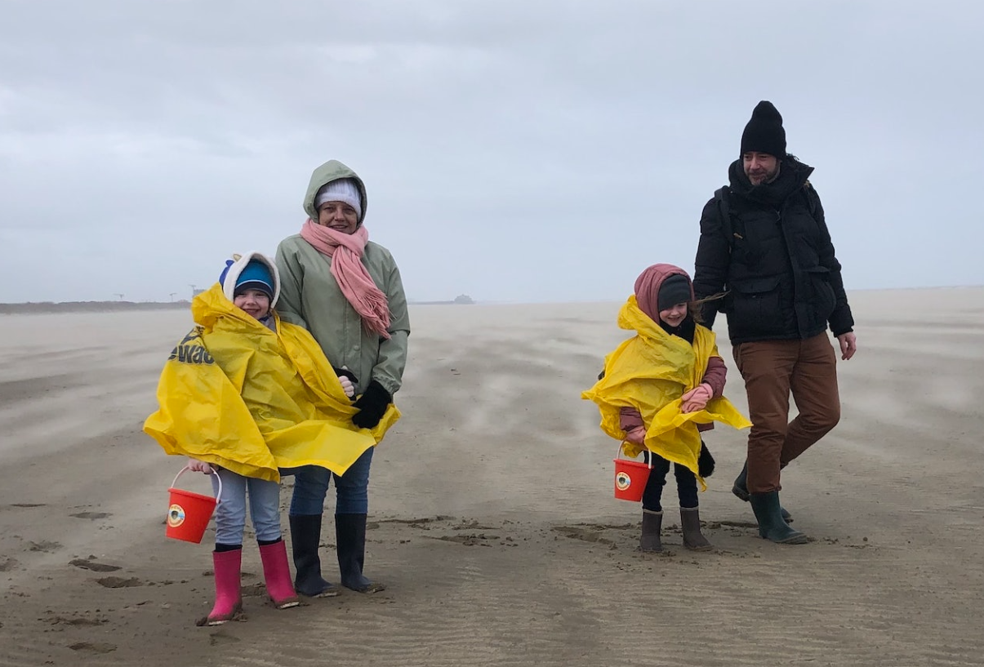

Slide 62
Every good citizen science project comes with a solid and sustainable communication plan
The building blocks of the communication plan
Engage with the target audience(s) in various ways
Use different media and formats to engage with the audience, such as online platforms and apps, in-person ro virtual workshops or training sessions, and educational outreach and events
Evaluate and improve the materials and activities
Evaluate the effectiveness of communication materials and activities through feedback surveys, data analysis, and participant interviews to ensure that information is clear, engaging, and meeting the needs of participants and aims of the project

Slide 63
Tactics and tools for communicating with participants, stakeholders, and the public
Use networks and offer fun experiences
Hitch a ride on existing networks
Partner up with organisations or networks to get in touch with specific audiences, achieving greater reach and impact
Often, it makes little sense to build a community from scratch
Offer fun and enjoyable experiences
Participating in citizen science should be educational, but unless it is also fun, it will not be sustainable, and participants may leave
Combine informational or educational activities with social events or special excursions or treats that will entertain the participants

Slide 64
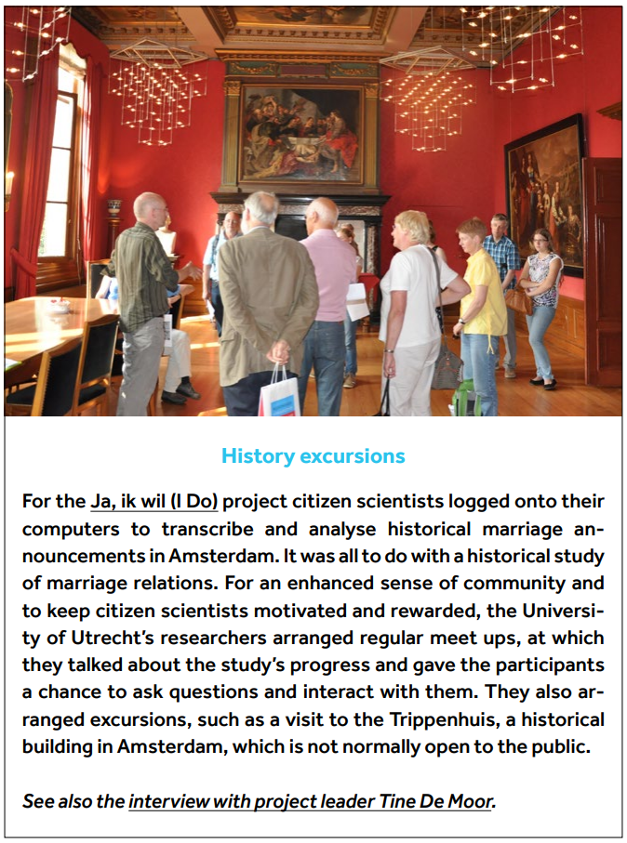
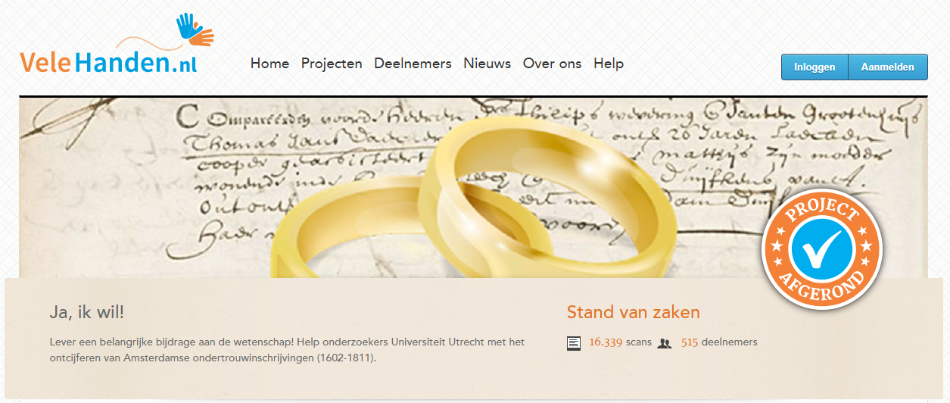
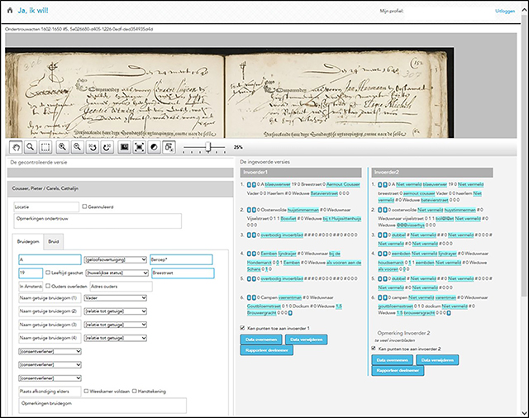

Slide 65
Tactics and tools for communicating with participants, stakeholders, and the public
Use social media and digital storytelling
Use social media to offer opportunities for interactions
Leverage different platforms to facilitate real-time communication, share project updates, and engage with large audiences, fostering a sense of community among participants and supporters
Digital storytelling can create a sense of belonging
Harness the power of digital storytelling to convey the project's narrative, share participant experiences, and highlight the impact of citizen science, making the project more relatable and engaging for a wider audience

Slide 66
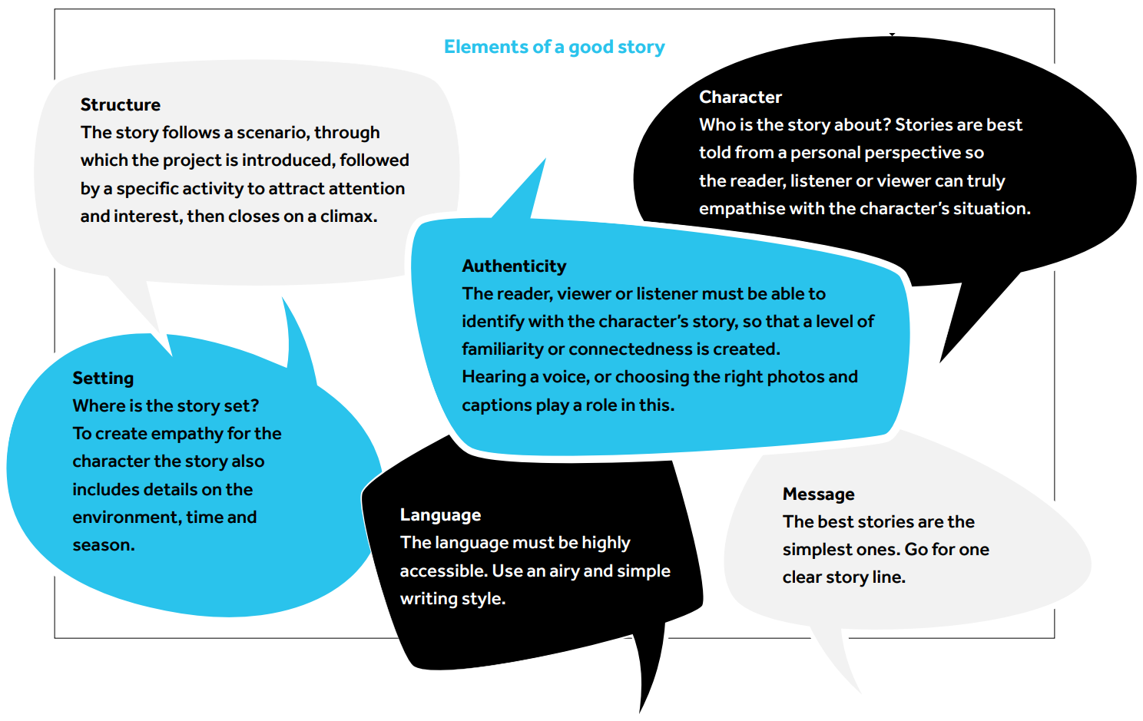
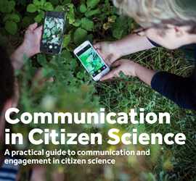

Slide 67
Tactics and tools for communicating with participants, stakeholders, and the public
Gamification and project ambassadors
Add gamification elements to the citizen science project
Apply game-design elements such as points, badges, rankings, missions, or "race against the clock" to make the tasks more enjoyable - be aware that they may also introduce potential biases
Find and train project ambassadors
They may help with your project's logistics, administration or communication in order to enhance outreach and engagement
They are usually intrinsically motivated to play a role in the project

Slide 68
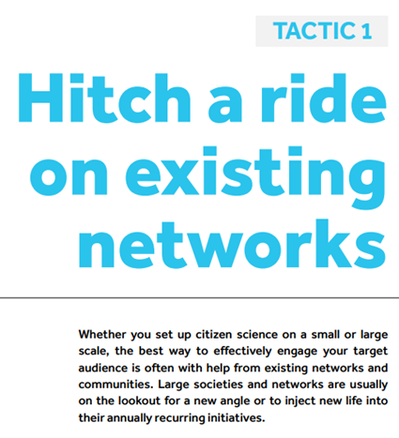
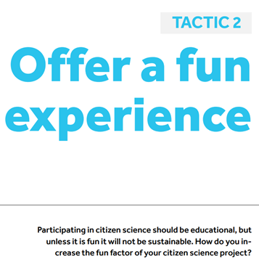
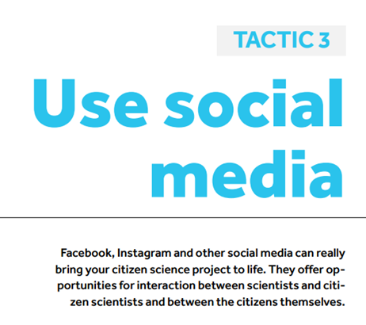
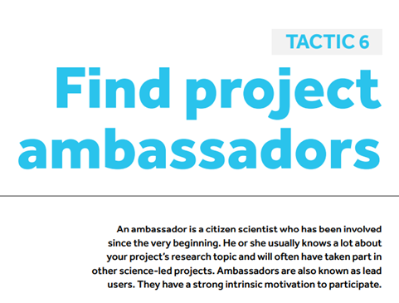
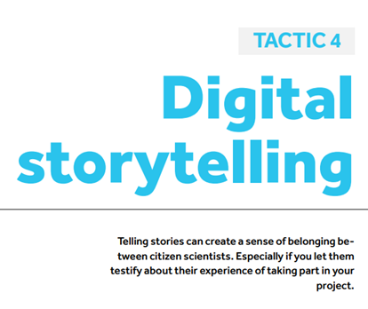
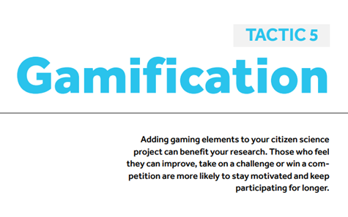

Slide 69
Crafting narratives and communication strategies in citizen science
Training Module 2.2.3: Interactive session

Slide 70
Interactive session: Crafting narratives and communication strategies in citizen science
Program | Tasks
Introduction | Present the two task options and distribute handouts with instructions and examples. Provide participants with large sheets of paper for their work and markers or other drawing tools (online if necessary).
Task Selection and Planning | Divide participants into small groups or set them up to work individually. Participants choose one of the two tasks: developing a story or selecting communication tactics. They brainstorm key elements or tactics/tools they wish to focus on.
Task Execution | For the storytelling task, participants sketch out the narrative of their chosen citizen science project, focusing on structure, characters, setting, and message. For the communication strategies task, participants list and elaborate on selected tactics and tools, considering how they would apply to a specific citizen science initiative.
Sharing and Feedback | Participants briefly present their stories or communication plans, highlighting the rationale behind their choices. Peers provide feedback, focusing on the clarity, engagement potential, and comprehensiveness of the narratives or communication strategies.
Conclusion | Summarize the importance of storytelling and strategic communication in citizen science. Encourage participants to incorporate these elements into their actual citizen science projects.

