Slide 1
Topic Area: Research & Methodology
TIME4CS Training Program 1

Slide 2
Intervention Area: Research
Training Program 1
Training Module 1.1: Research design and methodologies
Training Module 1.1.1: Citizen science methodologies
Training Module 1.1.2: Assessing the suitability of citizen science for your research
Training Module 1.1.3: Interactive session: Employing a decision framework to determine whether your ideas are suitable for citizen science
Training Module 1.2: Open science practices
Training Module 1.2.1: Data management and open science practices in citizen science projects
Training Module 1.2.2: Public engagement and volunteer management
Training Module 1.2.3: Interactive session: Navigating data management, volunteer management, and communication in citizen science projects

Slide 3
Intervention Area: Research
Training Program 1: Learning outcomes
Gain an understanding of Citizen Science (CS) methodologies within the broader context of Open Science (OS)
Acquire the skills to conceptualize and implement new research initiatives using CS approaches or integrate CS methodologies into existing research projects
Utilize structured decision frameworks to evaluate the appropriateness of CS for specific research projects or ideas
Master the principles of data management and public outreach in line with OS standards, using tools like the Data Charter for Citizen Science
Learn best practices for data management, including understanding FAIR (Findable, Accessible, Interoperable and Reusable) data principles and employing effective data hygiene, standards, and formats
Acquire skills in volunteer management and understand the motivations and journeys of volunteers in CS
Develop strategies for effective communication and public outreach, crucial for the success and impact of CS projects.
Through interactive sessions, learn to formulate action plans or pitches for CS projects, integrating learned concepts in data management, volunteer management, and communication

Slide 4
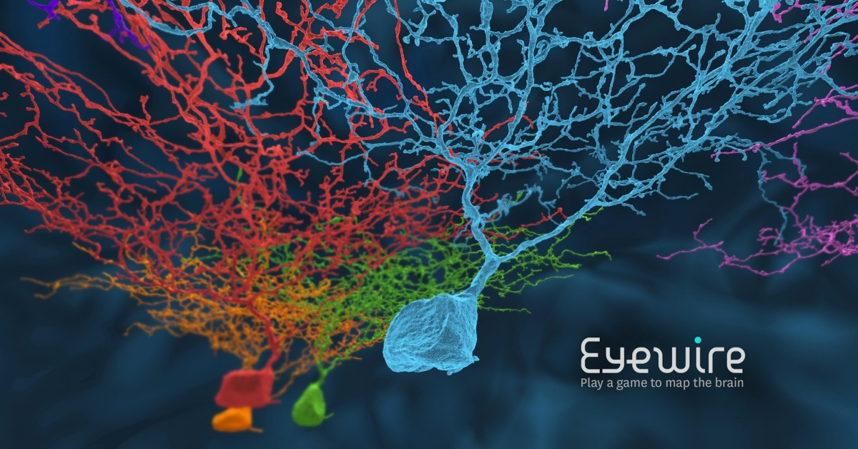
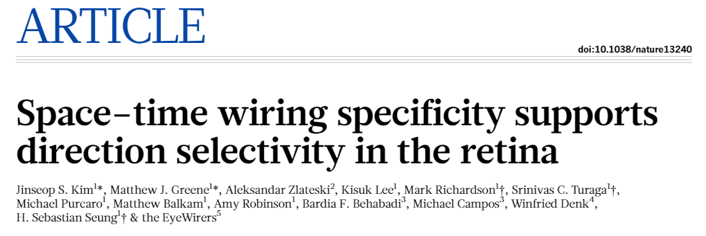
Eyewire – example
Mapping eye neurons
Launched 2012 >225.000 players >150 countries
Build a community – Know your community partners
Make it fun. Engage with your volunteers. Be social!
Sustain and Improve – Communicate effectively
Use social media, blog posts, emails; images have bigger impact
Sustain and Improve – Build flexibility into your project
Continue improving your project; take suggestions from volunteers!
Eyewire.org

Slide 5
Citizen science research design and methods
Training module 1.1

Slide 6
Citizen science methodologies
Training Module 1.1.1

Slide 7
Many types of citizen science - examples
Make computer power available for projects
Solve tasks online
Play games with research content online
Crowdfunding for science
Participate in public debates -> influence decisions
Participate in prioritization re. research
Hacker/maker spaces (Do-It-Yourself (DIY) labs)
Helping archives
Helping with fieldwork
Community science

Slide 8
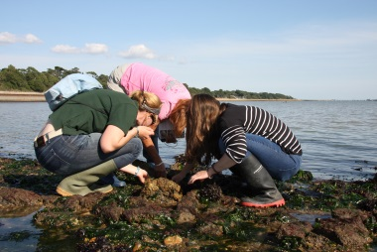
Citizen science – the term emerges
Democratisation of science
Alan Irwin (1995)
Democratic, participatory science
Science to address needs and concerns of citizens
Citizens could develop process of producing reliable knowledge themselves
Participants can influence and transform science
Amateur contributions to science
Audubon Society (1989) & Rick Bonney (1996)
Citizens collecting and analysing rain samples
Birdwatchers submitting sightings
Participants are instruments
CS now
Biodiversity monitoring
Activist science
Participatory action research
Community-based natural resource management
Public and Patient Involvement (PPI)

Slide 9
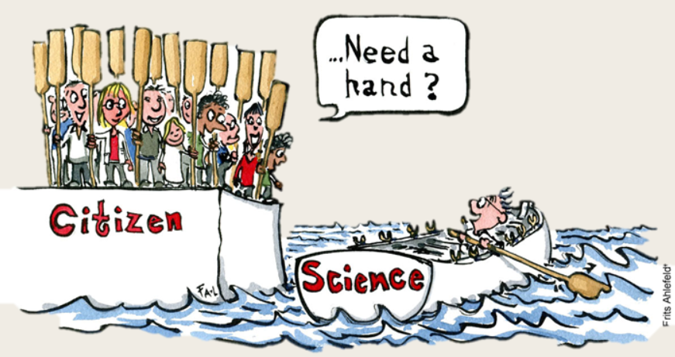
What is citizen science today?
“Scientific work undertaken by members of the general public, often in collaboration with or under the direction of professional scientists or scientific institutions”
(Oxford English Dictionary)
No overall agreed definition!
Public participation in scientific research
Crowdsourcing and crowdfunding
Distributed (hybrid) intelligence
Community science
Action (or activist) science
Respondents
Citizen science agreement
Contours of Citizen Science (Haklay et al. 2021)
Wide range of activities
Within a wide range of scientific fields

Slide 10
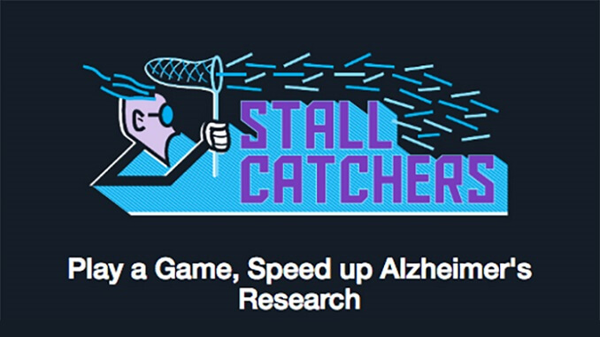
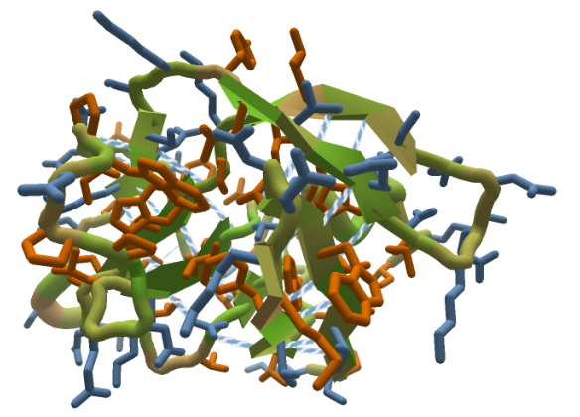
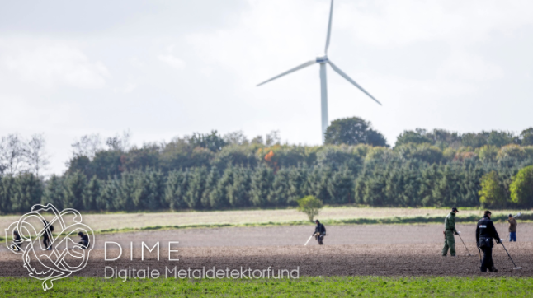
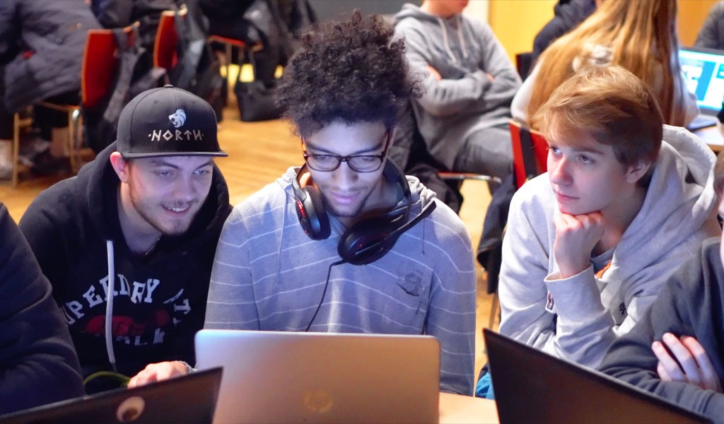
Wide range of fields
Citizen science
Ecology
Health
Physics
Meteoro-logy
Social science
Astronomy
”SDG monitoring”
Archaeo-logy

Slide 11
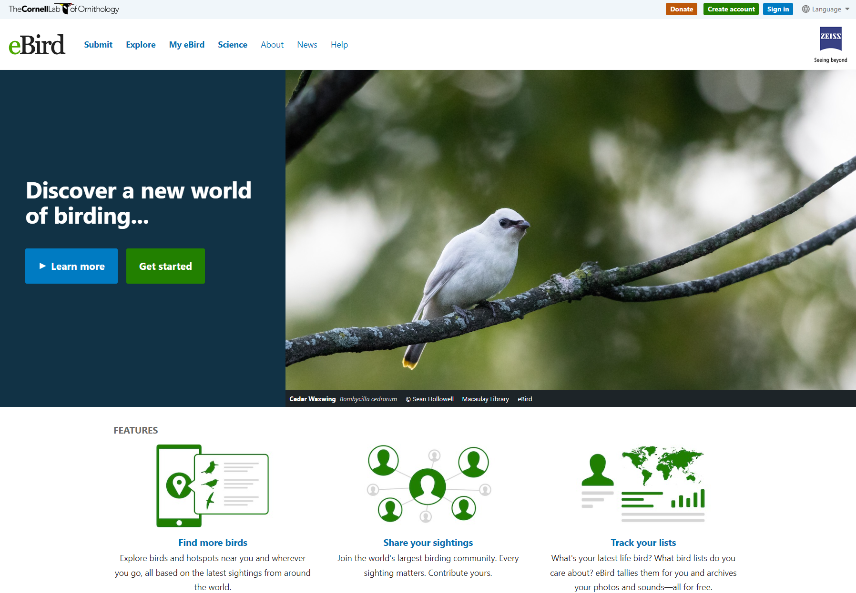
Worldwide
100s of partner groups
100 million obs / year
20% growth year on year
Birds are ecological indicators
Scope Your Problem – Engage stakeholders (both government and NGOs)
Build a Community – Know your community partners (participate in bird meetings & festivals)
Sustain & Improve – Adapt to cycles of participation (evaluate and adapt)

Slide 12
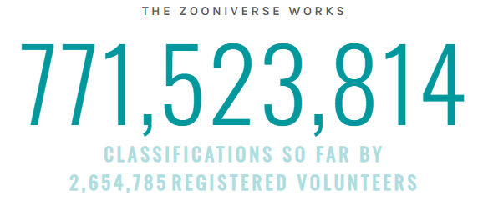
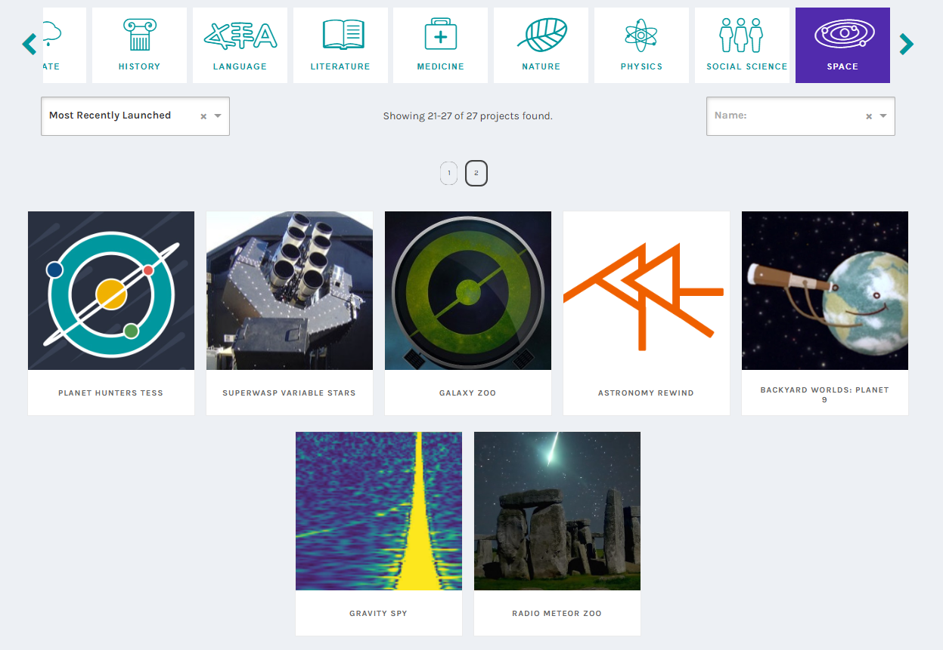
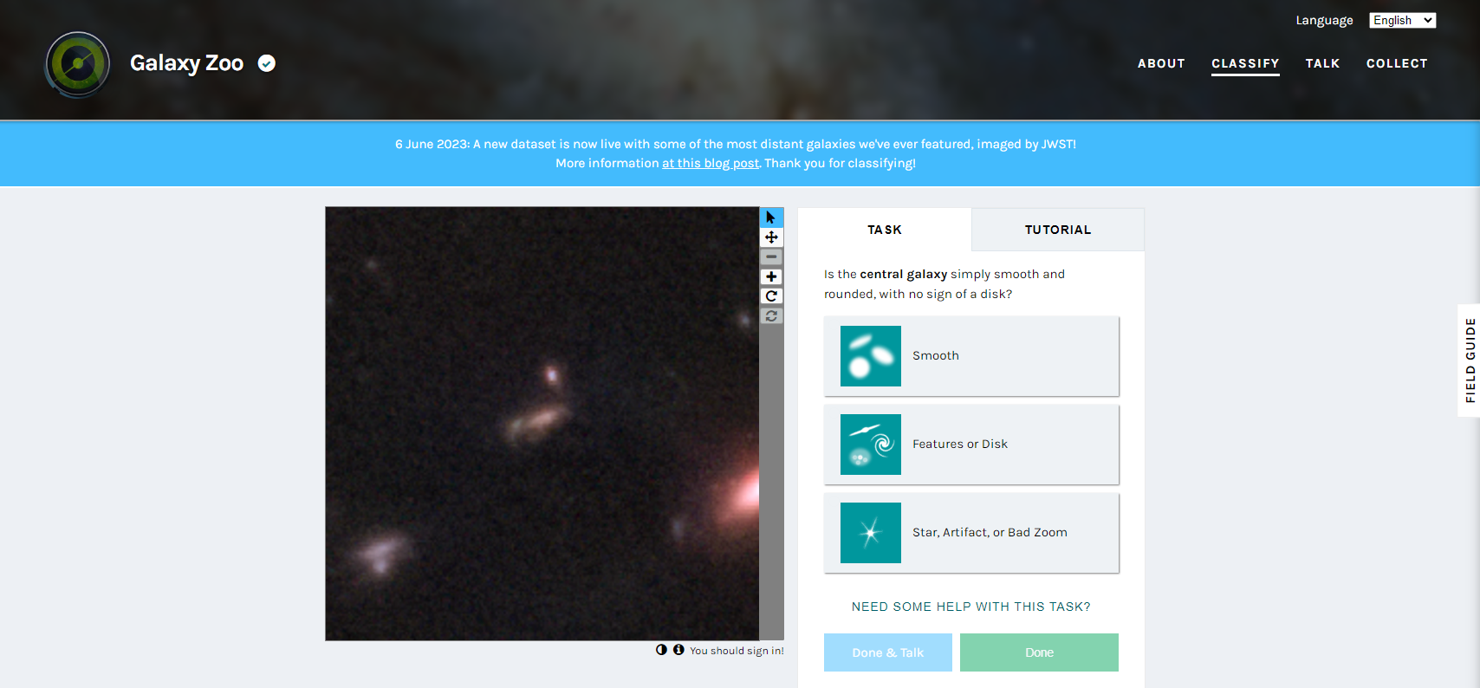
Crowdsourcing platform: Zooniverse

Slide 13
Gamification of research tasks - Foldit

Slide 14
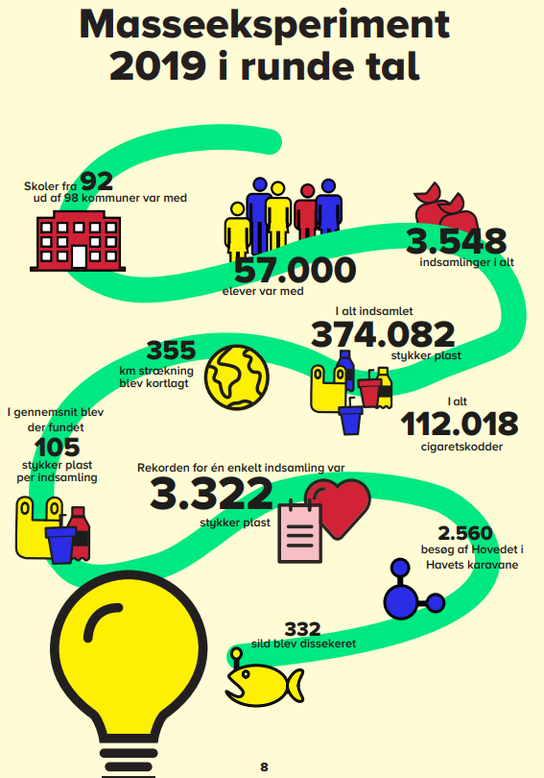
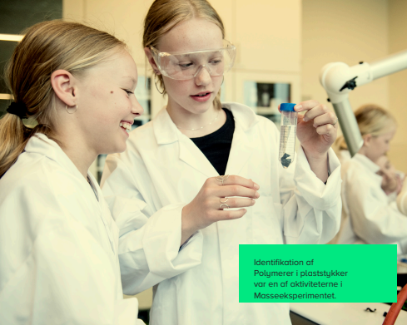
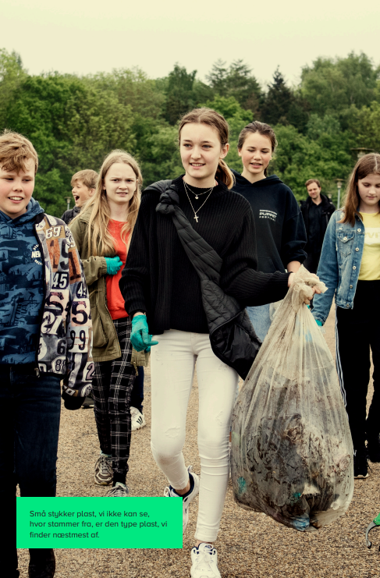
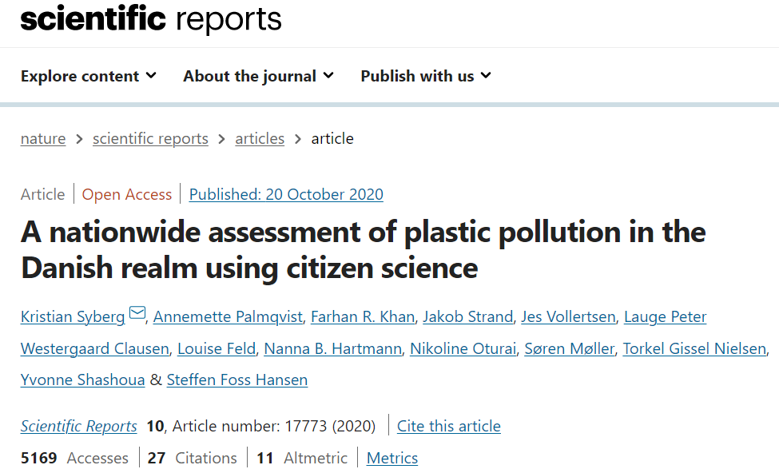
Involving school children
Masseeksperimentet (The Mass Experiment)

Slide 15
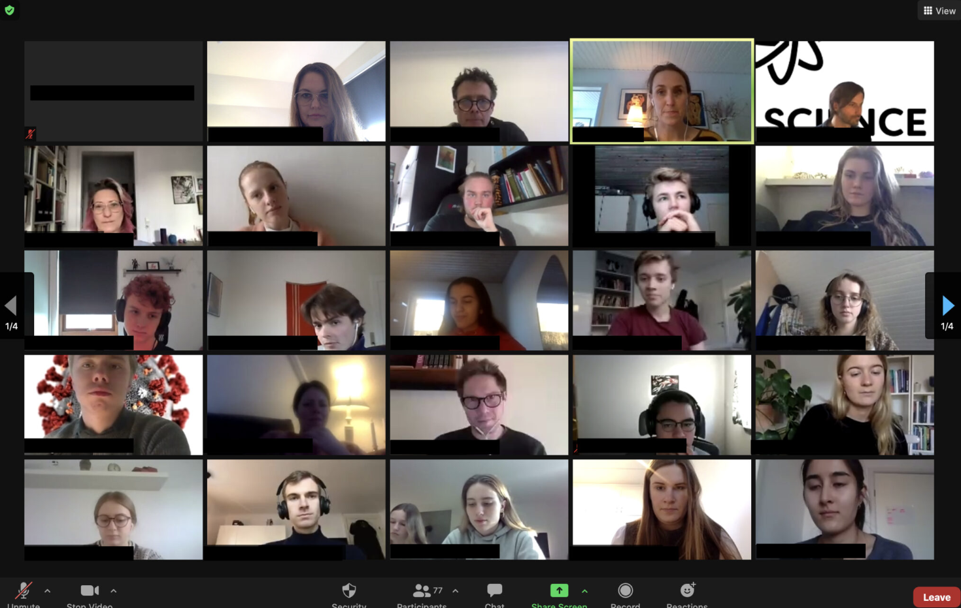
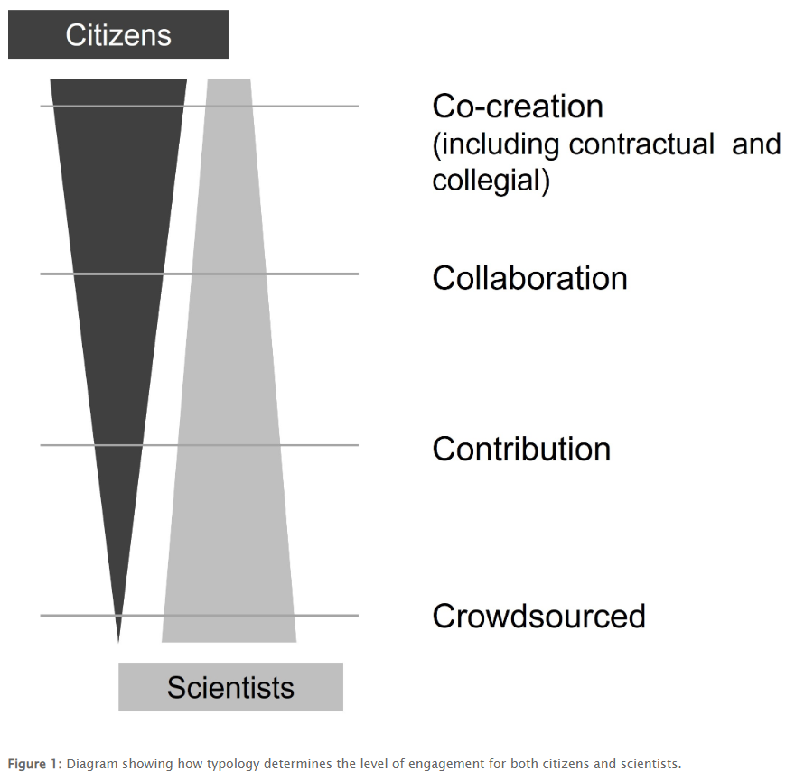
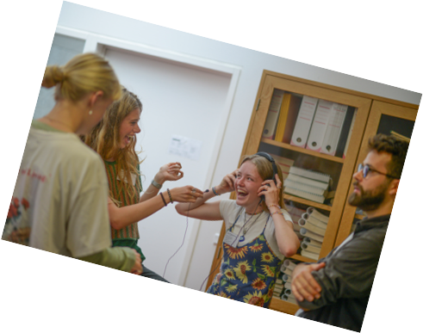
Make your bed
Covid lockdown coping mechanisms
You have to communicate more actively than before
Create daily structure, e.g. clear separation of ‘work space’ and ‘free time space’
Create your own spaces
Give Youth a Voice
3½ year project
Mental health, communication & data with and for youth
1775 young people involved (14-22 years old)
Unique youth perspective
Young peer-to-peer dialogues
2 tiers of involvement
https://givdeungeordet.dk

Slide 16
Co-creation, participatory, and community-based approaches

Slide 17
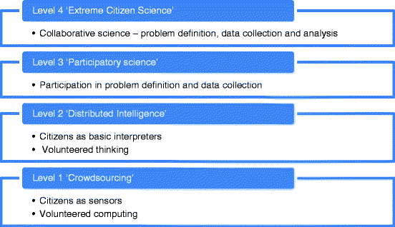
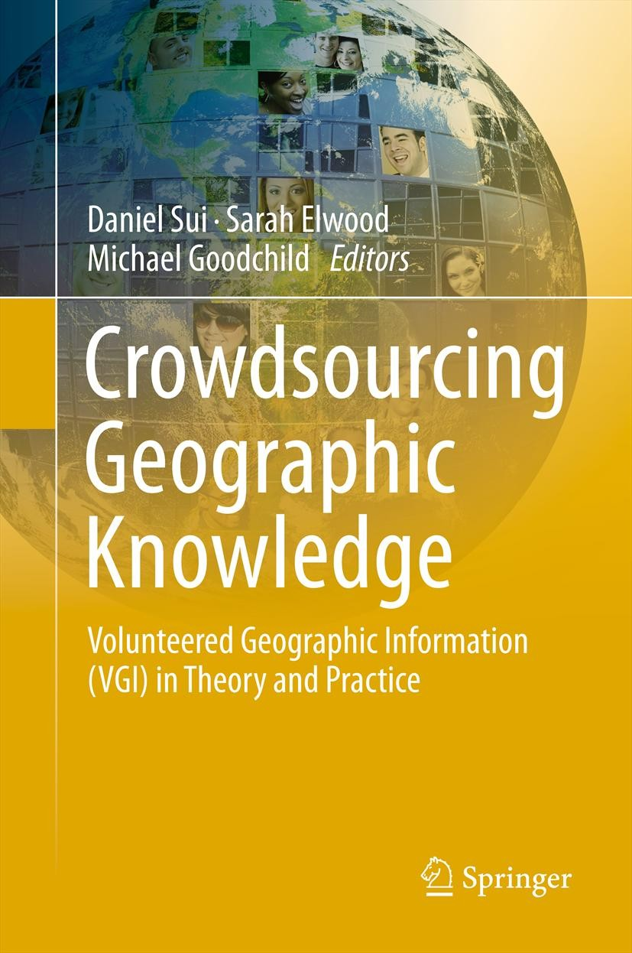
Citizen science methodologies by levels of participation

Slide 18
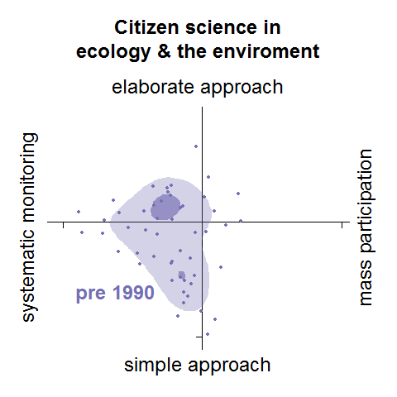
CS project types change over time
CS methods are not static but continuously evolve
Clear trend pre-1990 to 2014: from systematic and elaborate to mass participation and simple
(© Michael Pocock/CEH)

Slide 19
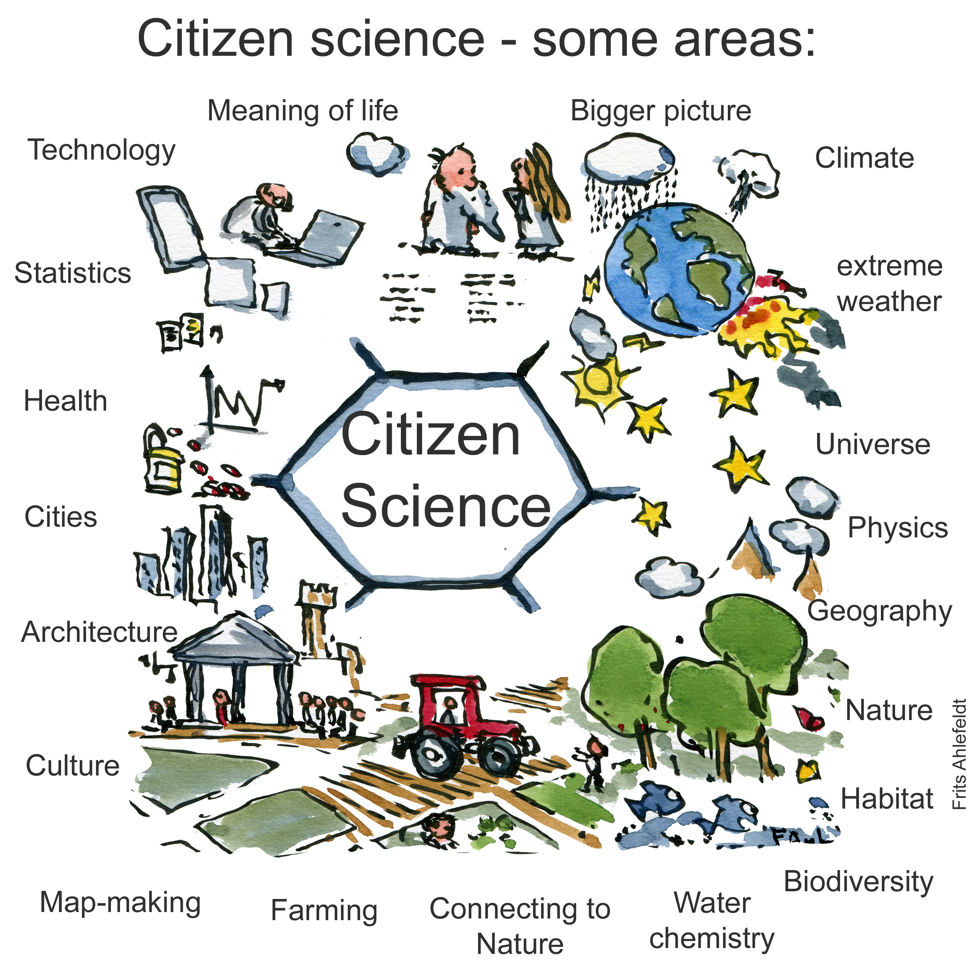
Summary
Many types of citizen science
From making computer power available, solving tasks & playing games online
To participation in debates and prioritization of research
And participation in the field and community science
Citizen science is an umbrella term for many different approaches to involving the public in research processes

Slide 20
Assessing the suitability of citizen science for your research project
Training Module 1.1.2

Slide 21
Reasons for choosing citizen science (or not)
CS advantageous when…
CS not advantageous when…
Training required not too technical
Public involvement serves goals
You want to promote STEM learning
You need data across large areas or over long time
You need many eyes on the ground
You need to analyse large amounts of data or images
Tasks can be completed online
Training or equipment is highly technical
Other goals to engage the public are more suited to your organization’s goals
Sampling needs to occur infrequently
Data collection is in remote /inaccessible areas
Risks for participants are identified

Slide 22
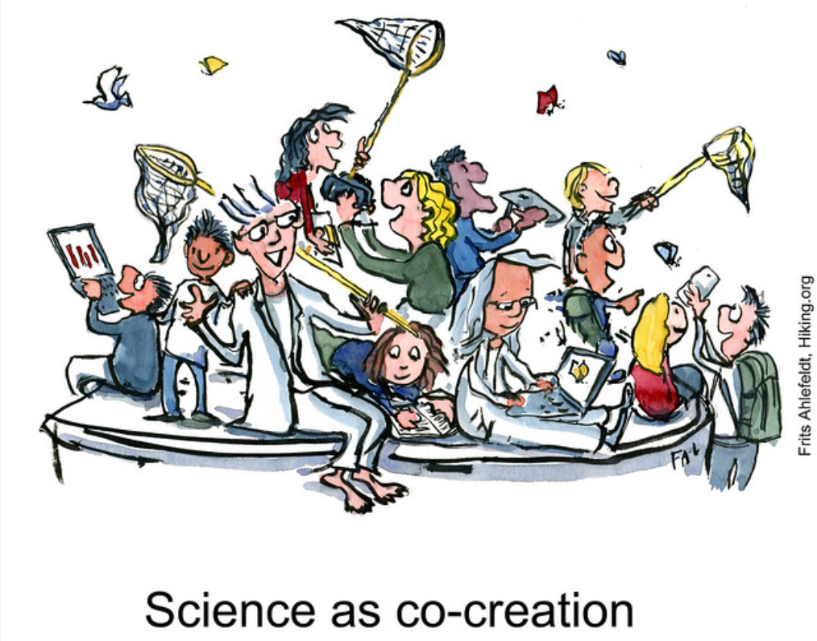
Defining project aims
Work out what you are trying to achieve
What do you want to study?
What is the problem, question or issue you are trying to resolve?
Do you want or need to reach a certain number of volunteers?
Promote student learning?
Involve a particular group of people?
What data will you collect, and how will it help you achieve your goal(s)?
How will you display your results to clearly show the connection to your aims?
How will you evaluate your project against your stated aims?
Make a timeline for your project

Slide 23
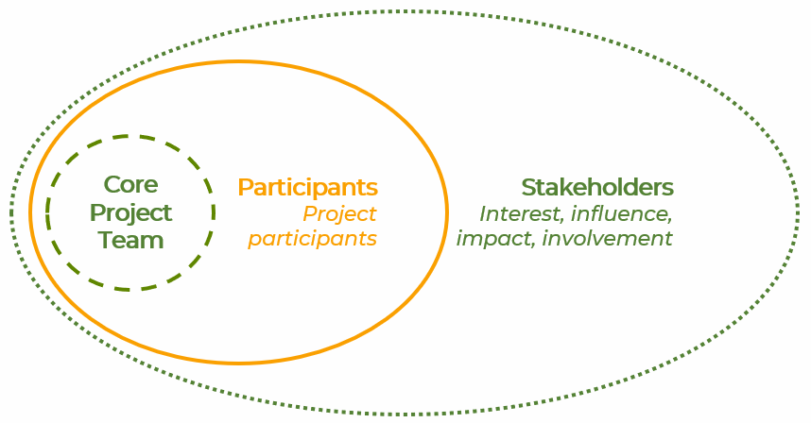
Stakeholder Analysis example: Timing/Stakeholders
Stakeholder mapping for Citizen Science project implementation
Participants
Participants
Participants
Participants
Stakeholders – any change agents?
Place your stakeholders according to when you need to involve them
External collaborators – break this down further, who are they?
Director / Board
Research Library Staff
Heads of Department
Early Career Researchers
Researchers
Funding Officers
Timing
Planning – Design – Coordination – Outreach – Execution – Evaluation – Follow-up
Participants

Slide 24
participants
AND researchers!
Ladder of Participation
for both
Co-creation & leadership
Personal action
Ambassador
Personal connection
Active
Training / awareness raising / education
Engaged
Aware
Unaware

Slide 25
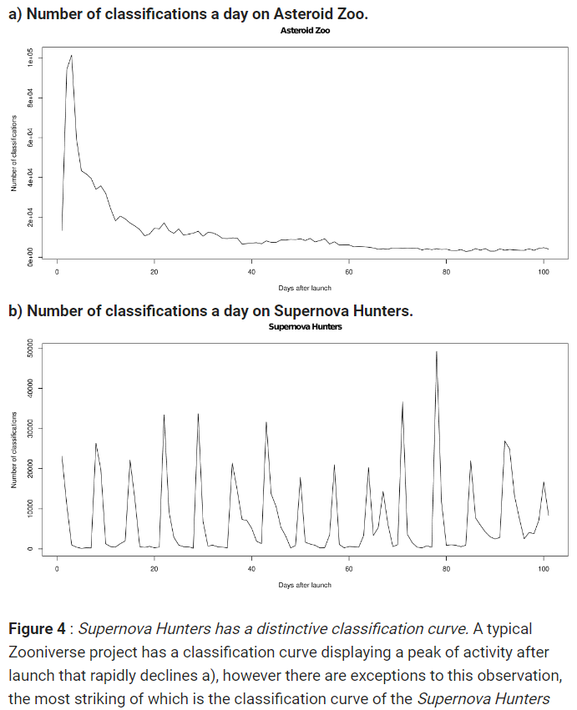
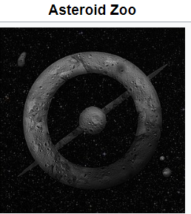
Defining project aims
Spiers, H., Swanson, A., Fortson, L., Simmons, B., Trouille, L., Blickhan, S. and Lintott, C. (2019). Everyone counts? Design considerations in online citizen science JCOM 18(01), A04. https://doi.org/10.22323/2.18010204

Slide 26
Defining project aims
Spiers, H., Swanson, A., Fortson, L., Simmons, B., Trouille, L., Blickhan, S. and Lintott, C. (2019). Everyone counts? Design considerations in online citizen science JCOM 18(01), A04. https://doi.org/10.22323/2.18010204

Slide 27
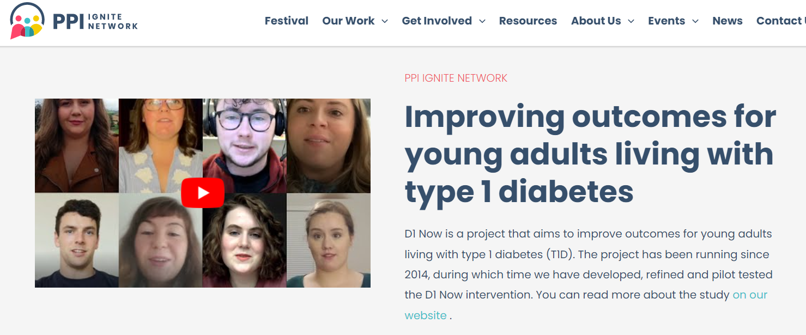
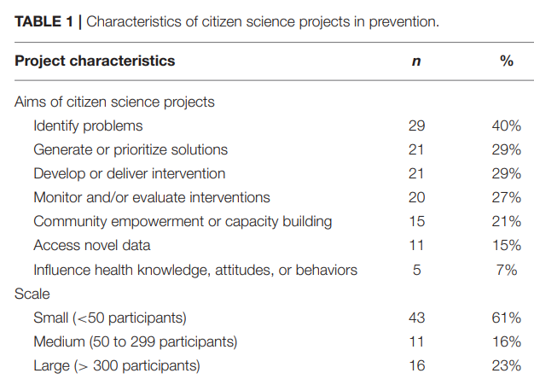
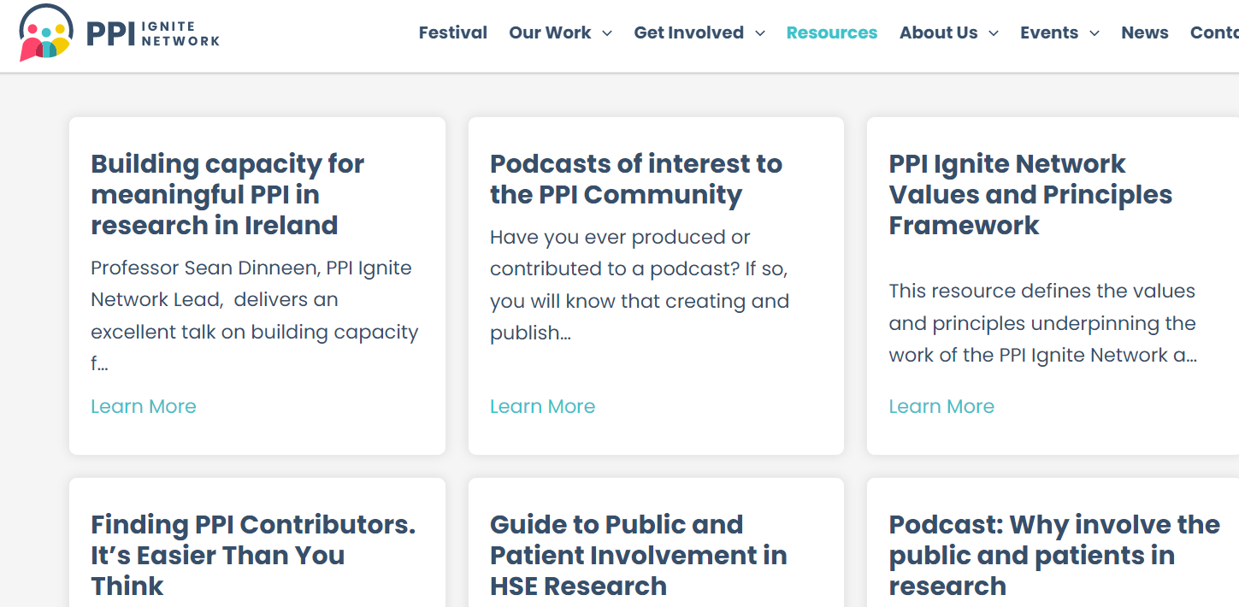
Public & Patient Involvement (PPI)
Marks et al. 2022: A Scoping Review of Citizen Science Approaches in Chronic Disease Prevention

Slide 28
Volunteers’ motivations
Environmental monitoring projects
Motivational function | Specific motivation | Sources
Values | Interest in wildlife Concern for the environment, wildlife or conservation | Weston et al. 2006, Davies et al. 2011, Hobbs and White 2012, Johnson et al. 2014, Wright et al. 2015, Geoghegan et al. 2016, Martin et al. 2016
 | Contribution to science and data collection | Davies et al. 2011, Hobbs and White 2012, Wright et al. 2015, Geoghegan et al. 2016, Martin et al. 2016
Understanding | Desire to learn and exchange knowledge | Bell et al. 2008, Thiel et al. 2014, Martin et al. 2016
Recreation / Enhancement | Opportunity to spend time in nature or outdoors | Bell et al. 2008, Johnson et al. 2014, Wright et al. 2015
 | Gaining public recognition for their efforts | Thiel et al. 2014
Social | Social interactions | Bell et al. 2008
 | Collectivism | Rotman et al. 2012

Slide 29
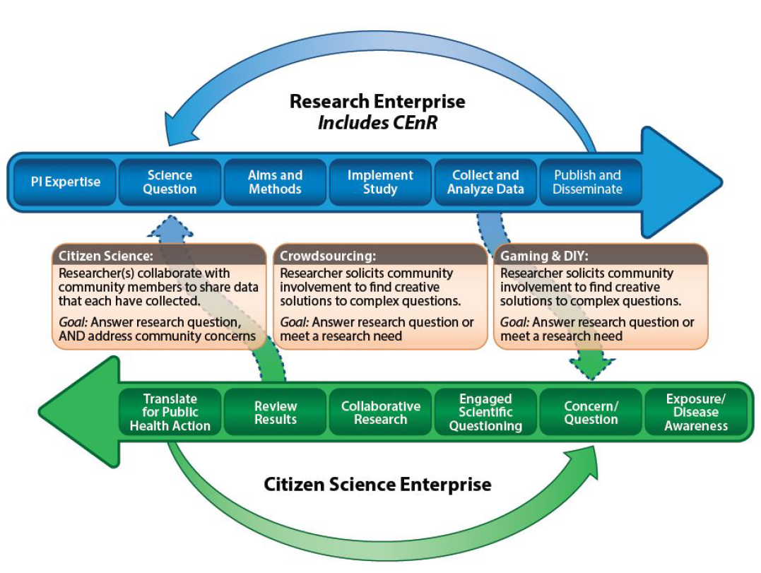
Citizen science methodologies by levels of participation

Slide 30
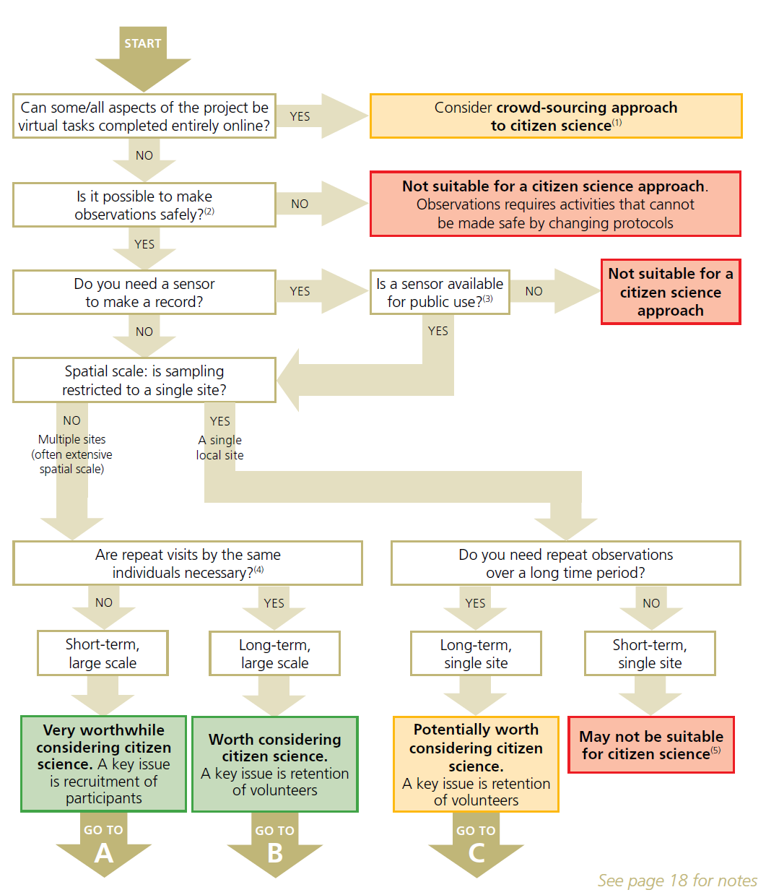
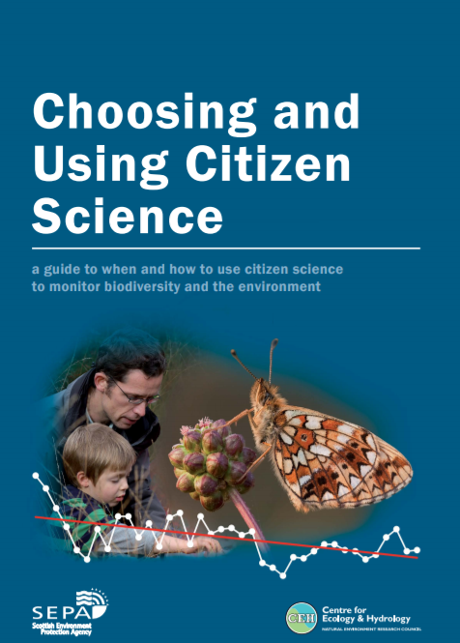
CS is a method like any other scientific method
– only use when appropriate!
Setting up for success
Pocock et al. 2014: https://www.ceh.ac.uk/citizen-science-best-practice-guide

Slide 31
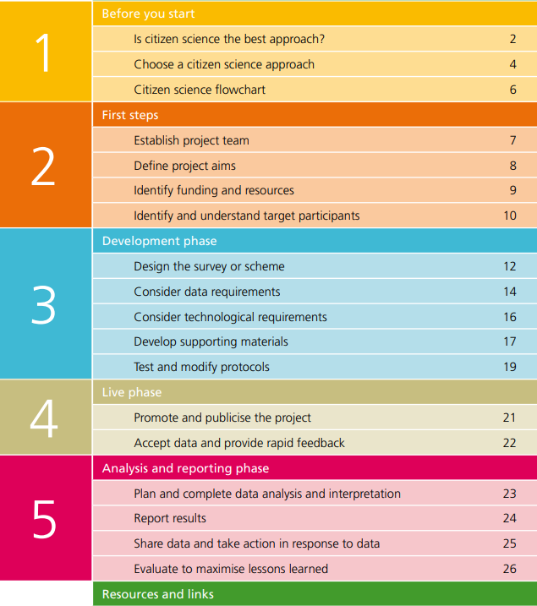
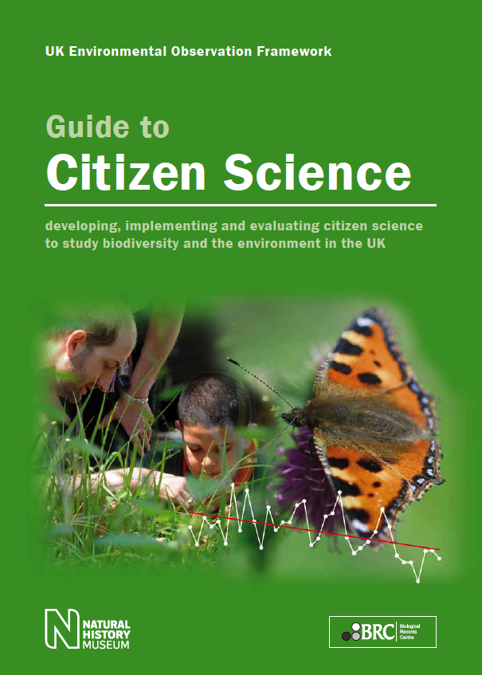
CS is a method like any other scientific method
– only use when appropriate!
Setting up for success
Pocock et al. 2014: https://www.ceh.ac.uk/citizen-science-best-practice-guide

Slide 32
Employing a decision framework to determine whether your ideas are suitable for citizen science
Training Module 1.1.3: Interactive session

Slide 33
Interactive session: Using a decision framework to decide whether your ideas are right for CS
Program | Task
Group discussion | Participants discuss the various aspects of their projects, such as the research question, target community, expected outcomes, and potential challenges. They are encouraged to share their project ideas or existing projects.
Applying the framework | Each participant or group applies the decision framework to their project idea or existing project. This involves systematically evaluating their project against the criteria outlined in the framework.
Identifying opportunities and challenges | Participants identify the opportunities that CS could bring to their project, such as increased data collection, broader public engagement, and enhanced community relevance. They also discuss potential challenges, including managing volunteer contributions, ensuring data quality, and addressing ethical considerations.
Presentation and feedback | Participants or groups present their assessments in a two-minute pitch, outlining whether CS is suitable for their project and why. Presentations are followed by a feedback session, where peers and/or facilitators provide constructive comments, alternative perspectives, and suggestions for improvement.
Conclusion and reflection | The session concludes with participants reflecting on their learning experience. They consider how the decision framework has influenced their understanding of the applicability of CS to their research.

Slide 34
Open science practices in citizen science projects
Training Module 1.2

Slide 35
Open data management and open access
Training Module 1.2.1

Slide 36
The benefits of open science
Open science offers an array of benefits across five domains
Supporting the growth of the knowledge economy/society
Reciprocity between research, innovation, civil society, and governance
Improving the integrity, reliability, and transparency of research
Enhanced credibility and legitimacy for scientific research
Generating social and public benefit
Social needs articulated by the public inform greater share of research
Strengthening scientific literacy and education
A rigorous and inquisitive approach and better informed decisions
Improving public policy and democracy
Flow of knowledge from science into policy-making and deliberation

Slide 37
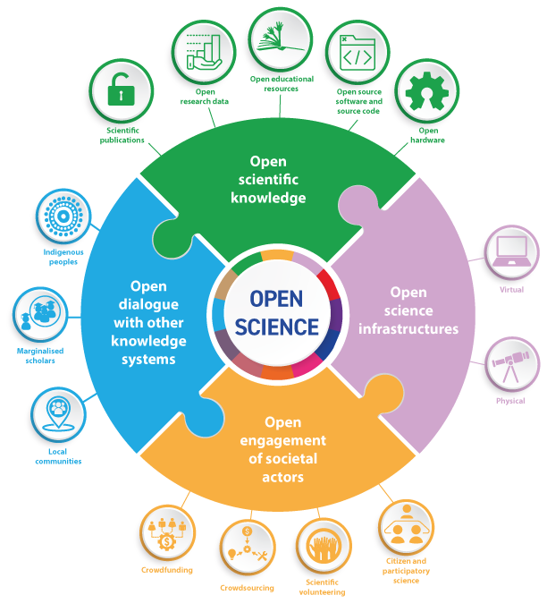
Components of open science
Citizen science as open science
Engagement with societal actors and stakeholders
Enhanced dialogue between scientists, policymakers and practitioners, entrepreneurs and community members (knowledge holders)
Access to infrastructures of scientific knowledge production and dissemination
Shared repositories for data and code, publication platforms, open labs, etc.
UNESCO Recommendation on Open Science, 2021

Slide 38
What is FAIR Data? Why is FAIR Data important to citizen science?
FAIR = Findable, Accessible, Interoperable, Reuseable
Enhanced findability, accessibility, and learning opportunities
Enables diverse participation and fosters inclusivity and learning
Increased engagement, collaboration, and innovation
Facilitates effective collaboration leading to innovative solutions and the development of new research projects
Improved data quality and validation
Allows broader scrutiny for error identification and correction, and enables validation through replication and reanalysis
Public value and impact
Promotes the broader dissemination of research, informing decision-making and enabling advocacy for community changes

Slide 39
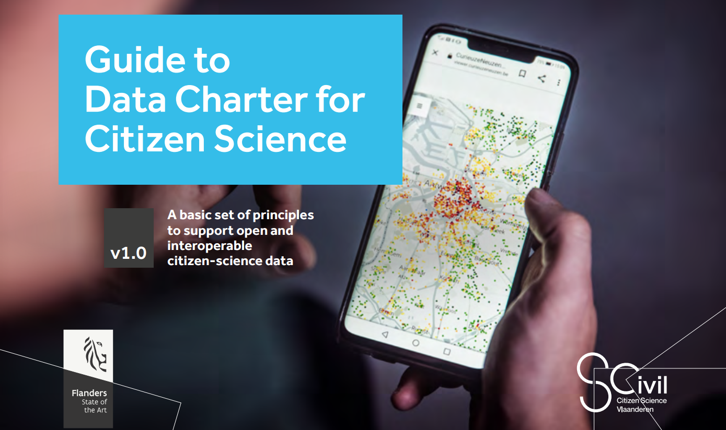

Slide 40
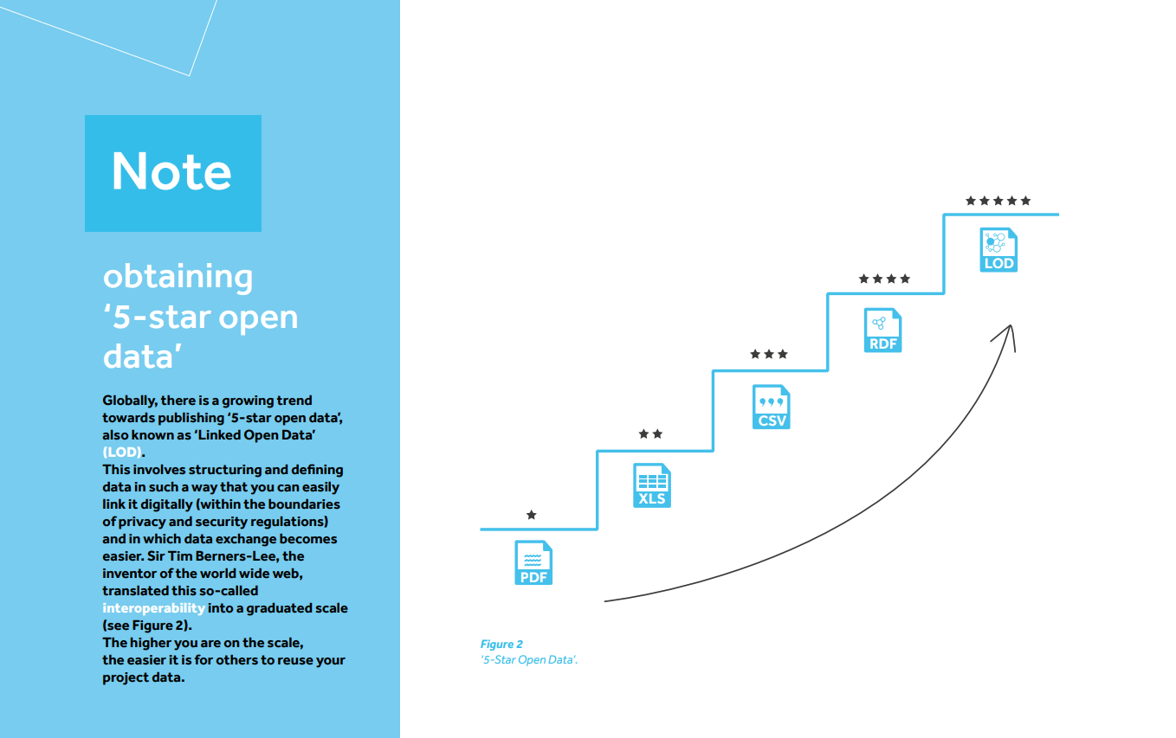

Slide 41
Introducing the open attitude
How to make your citizen science “stuff” available on the web (whatever format) under an open license
Aim to publish your data openly on the web, or give a clear and well-founded reason if this is not possible
Publish your data under an open licence that you choose from a short, recommended list
For example, the Creative Commons license or the Open Data Commons
Publish your research results and findings where possible in Open Access Journals
Where possible, also publish the software you develop under open licences
Actively seek for open data – and seek advice from support services
For example, the library or open science officers

Slide 42
Privacy and ethics challenges
How to maintain adherence to privacy and ethics standards in citizen science projects
Informed content and transparent communication
Prioritize obtaining clear and informed consent from participants, ensuring they are fully aware of the project’s goals, risks, and their rights
Maintain open and transparent communication about project goals, data usage, and results, forstering trust and collaboration
Data protection measures
Implement robust data protection measures such as encryption and anonymization to safeguard sensitive information (GPDR compliance)
Diversity and inclusivity
Promote diversity and inclusivity in project participation, making it accessible and equitable to different demographics, and considering diverse needs and perspectives in project design and implementation

Slide 43
Data hygiene in citizen science
How to ensure the cleanliness, accuracy, and quality of citizen-science data within a database or information system
Data validation and regular data audits and cleaning
Apply rigorous data validation techniques to ensure the accuracy and consistency of the collected data
Identify and rectify errors, duplicates, and inconsistencies to maintain data integrity and prevent the propagation of incorrect information
Maintain data security and privacy
Employ robust security measures and privacy protocols to protect data from unauthorized access, loss, or corruption
Standardize data collection and management
Develop and adhere to standardized protocols for data collection, entry, and management, ensuring uniformity and consistency in data handling, facilitating easier analysis, and interpretation of citizen-contributed data

Slide 44
Data management in citizen science
How to secure the coherence, reliability, and enhanced usability of the collected data
Clear, consistent and standardized data protocols
Establish and communicate clear data collection, processing, and management protocols, ensuring standardized guidelines and procedures
Adopt and enforce data standardization norms and formats to ensure uniformity and consistency across datasets, facilitating seamless integration, analysis, and interpretation of the collected data
Metadata management and the linking of datasets, if possible
Emphasize the creation and management of comprehensive metadata to provide detailed descriptions of the data, offering context and enhancing the understandability, discoverability, and usability of the datasets
Facilitate the integration and linking of datasets across different projects, promoting interoperability and collaboration

Slide 45
Data management in citizen science
A decision-framework approach to data management providing a structure to evaluate alternatives systematically
Define data management objectives
Ensure data management objectives align with the overall goals of the citizen science project: specifying the type, quality, and format of data to be collected, managed, and analyzed
Establish data standards and protocols
Define the acceptable formats, quality criteria, and metadata requirements, enabling uniformity and enhancing the usability and interoperability of the collected data
Evaluate and optimize data management practices
Monitor compliance with the established standards and protocols, addressing any discrepancies, and adapting practices as needed to accommodate evolving project needs and technological advancements

Slide 46
Public engagement and volunteer management
Training Module 1.2.2

Slide 47
Volunteer management
What is volunteer management? Why is it important to citizen science?
Definition of volunteer management
Volunteer management in citizen science refers to the systematic coordination and organization of volunteer contributions, including the recruitment, training, support, and development of volunteers, to optimize their involvement and ensure the effective execution of the project
Enhancement of volunteer contribution
Effective volunteer management is crucial as it optimizes the engagement and contributions of volunteers, ensuring their skills and efforts are utilized productively and contribute effectively to the achievement of project goals
Sustaining volunteer participation
High levels of volunteer motivation and satisfaction help to ensure the retention of participants and foster a sense of community and belonging

Slide 48
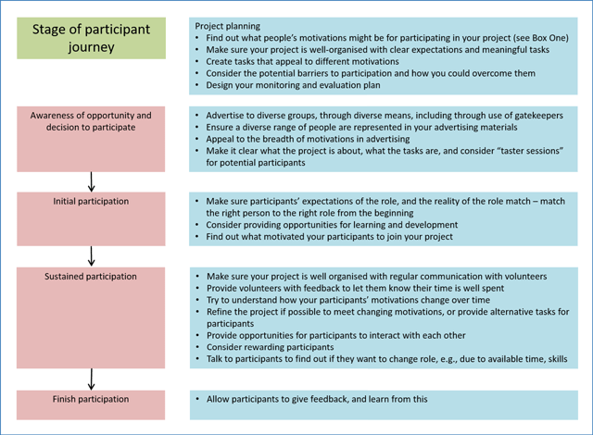
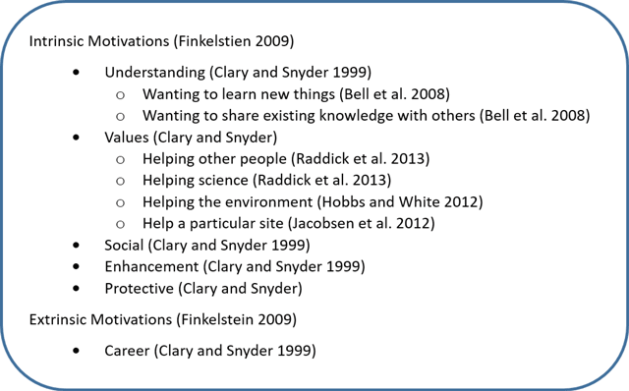
Factors that influence the volunteers’ journey

Slide 49
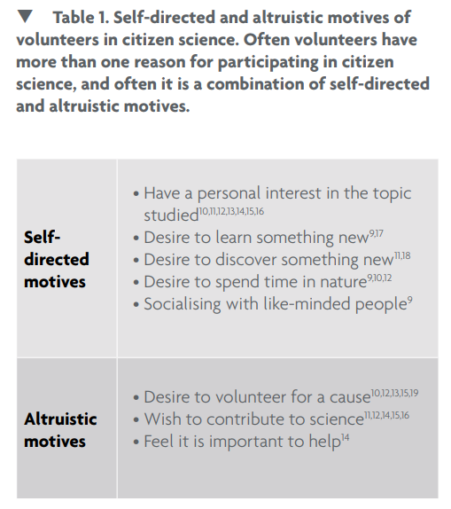
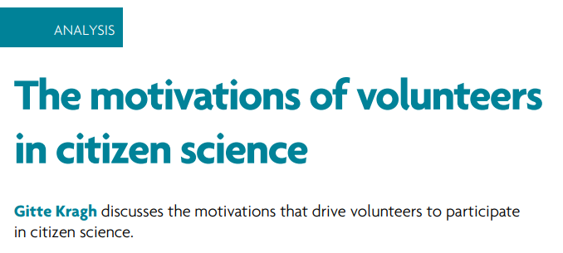
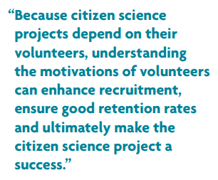

Slide 50
Checklist for project organizers

Slide 51
Volunteer management in citizen science
How to create an informed and motivated environment conducive to the success of citizen science projects
Implement efficient onboarding processes
Develop and implement comprehensive onboarding and training sessions to ensure clarity and understanding of project goals and to equip volunteers with the necessary skills and knowledge, fostering a sense of confidence and preparedness amongst participants
Maintain regular communication
Establish consistent communication channels for ongoing engagement, providing regular updates, feedback, and support, to keep volunteers informed, motivated, and valued, thereby sustaining participation and enthusiasm

Slide 52
Volunteer management in citizen science
How to create an informed and motivated environment conducive to the success of citizen science projects
Adopt effective organizational practices and tools
Embrace organizational practices that are structured and efficient to enhance volunteer engagement, such as clearly defined roles, responsibilities, and workflows, enabling volunteers to contribute more effectively and feel a stronger connection to the project
Leverage volunteer management software to organize, coordinate, and monitor volunteer activities efficiently
Recognize and value contributions
Regularly acknowledge and appreciate volunteer efforts and contributions, fostering a sense of value and accomplishment, which boosts morale, encourages ongoing participation, and aids in volunteer retention

Slide 53
Communication and engagement
How to foster engagement, build trust and community, and facilitate ongoing learning and improvement
Five phases to design a communication plan
Define projects aims, decide the level of engagement, and set clear communication objectives
Identify target audience (volunteers and others) in terms of their interests, expectations and motivations to participate
Choose appropriate channels and tools to leverage accessible and interactive platforms that best reach the intended audience
Establish regular and transparent communication with consistent updates, sharing progress, and being open about challenges and changes, keeping volunteers informed, engaged, and motivated, enhancing their learning and sense of connection and commitment to the project
Evaluate and adjust strategy, considering feedback and changing circumstances to enhance its impact

Slide 54
Navigating data management, volunteer management, and communication
Training Module 1.2.3: Interactive session

Slide 55
Interactive session: Navigating data and volunteer management, and communication
Program | Task
Topic breakdown | The session focuses on three topics: data management, volunteer management, and communication/public outreach. Participants are instructed to dedicate a section of their flip chart (or Miro board) to each topic (alternatively choose one topic to focus on).
Brainstorming and discussion | For each topic, participants brainstorm and discuss key words, concepts, or principles they have learned. They are encouraged to reflect on the content covered in this module, drawing upon specific examples and best practices discussed.
Flip chart (or Miro board) creation | Participants then translate their brainstorming into a visual representation on the flip chart (or Miro board). They are encouraged to be creative, using diagrams, keywords, and bullet points to capture the essence of each topic.
Presentation and feedback | Each group or individual presents their flip chart, explaining their choice of keywords and concepts. This is followed by a feedback session where other participants and/or the facilitator can offer insights or ask questions to deepen the understanding.
Reflection and conclusion | The session concludes with a reflective discussion, allowing participants to share what they found most valuable and how they might apply these concepts in their own CS projects.

